Slide 1
Teaching IP in a business school: interdisciplinary hurdles
Helen Gubby
RSM - A force for positive change

Slide 2

1. Law and IP
What is the nature of law?
What is intellectual property (IP) law?

Slide 3
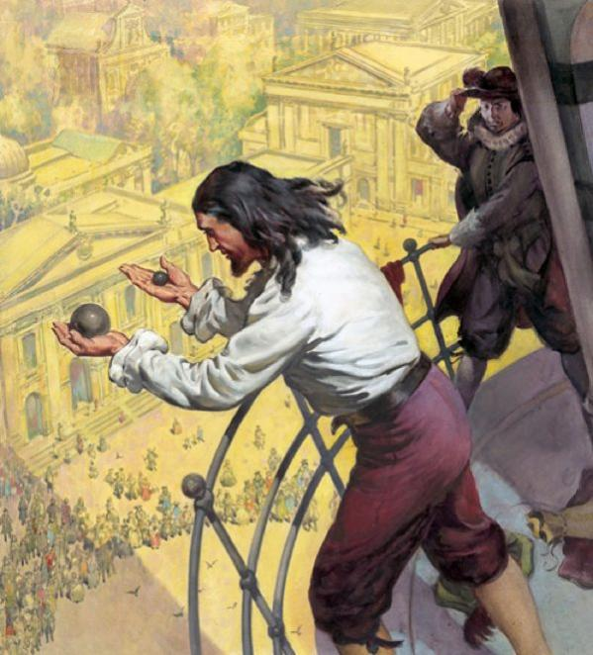
The nature of law
Jurisdictional laws are not like fundamental scientific principles.

Slide 4
The nature of law
Law is a command proceeding from the supreme authority of a state, and addressed to the persons who are subjects of that authority.
Laws reflect the predominant norms and values of a given society at a given point in time.
These norms can shift over time.

Slide 5


Illustrating shifting norms: patent law
Position in Europe
New position USA

Slide 6
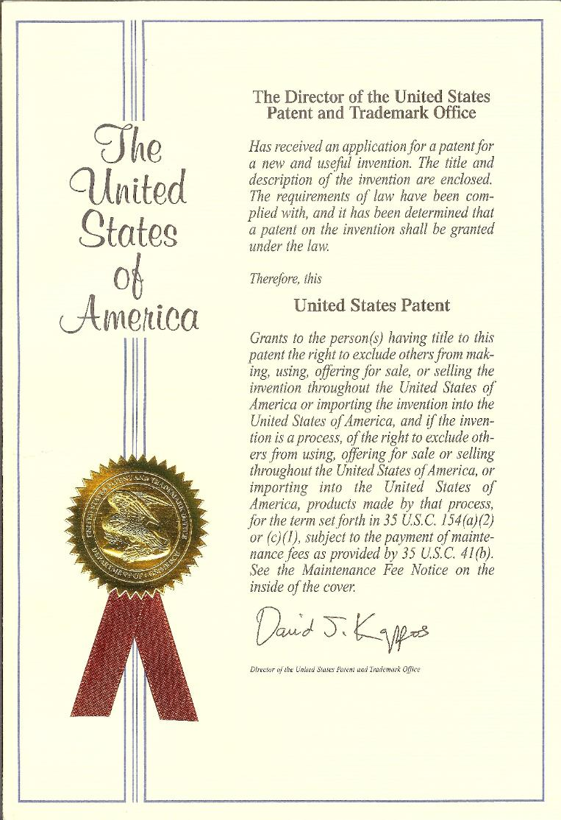
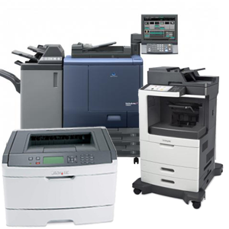
IP as property
IP belongs to the legal category of personal property. It also belongs to the sub-category of intangible property.
Tangible property

Slide 7
2. The nature of legal reasoning
Students usually expect that law is a set of black and white rules that simply have to be applied to the facts of a case.
What they learn is that the law is often grey: lawyers cannot always predict with anything like certainty how legal rules will be interpreted.

Slide 8
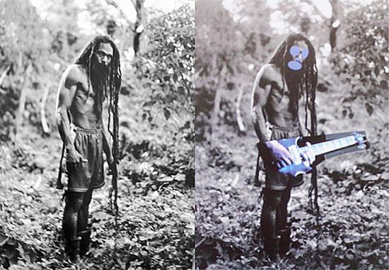
Is this copyright infringement?
Cariou vs Prince 2009-2014

Slide 9


Is this trademark infringement?
Gucci v Guess: was this infringement of the Gucci Quattro G pattern trademark?

Slide 10

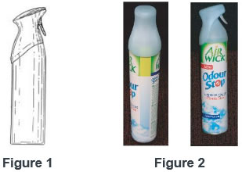
Design infringement?
Proctor and Gamble
Reckitt Benckiser
Figure 1 is P&G
Figure 2 is Reckitt

Slide 11

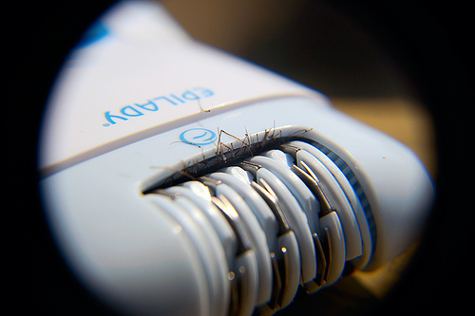
Patent infringement?
Improver’s Epilady
Remington’s Smooth & Silky

Slide 12
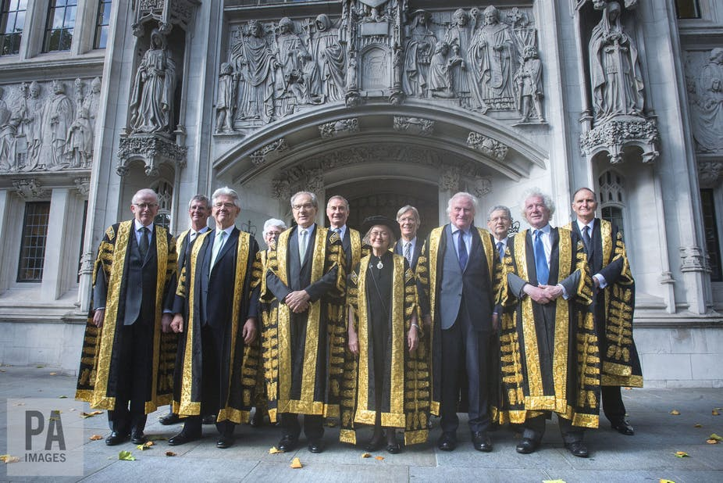
The Improver v Remington case: did the UK find infringement?

Slide 13
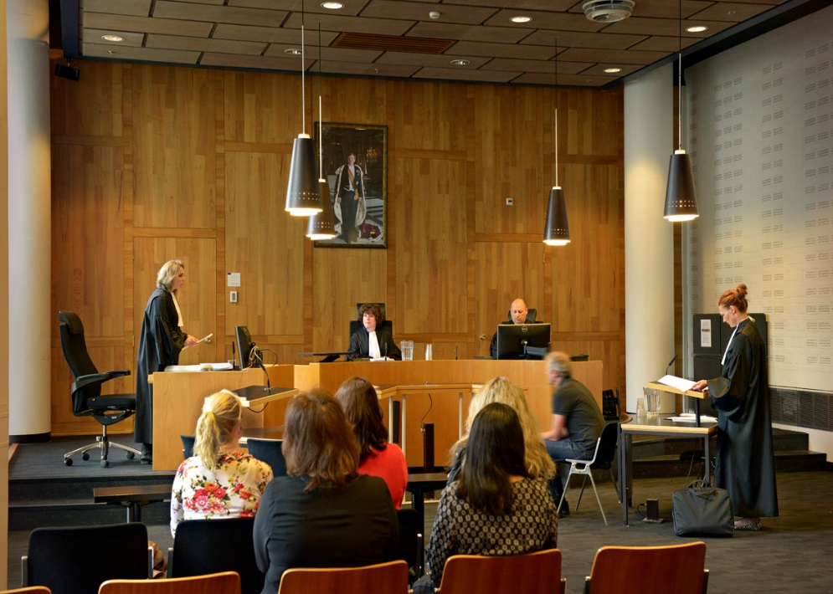
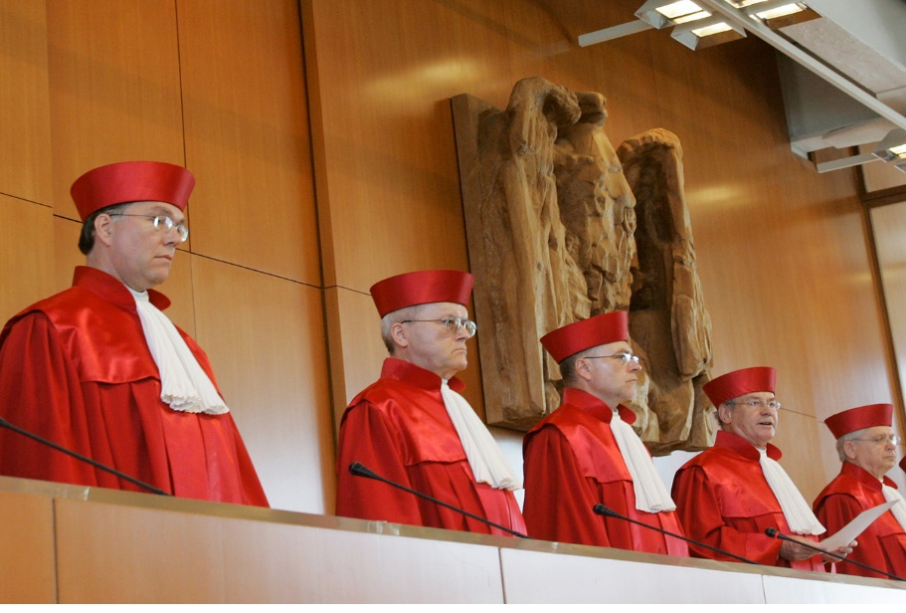
The Improver v Remington case
Improver Corporation v Beska B.V. & Remington
Improver Corp. & Sicommerce AG v. Remington
The Dutch court case. Did it find infringement?
The German court case. Did it find infringement?

Slide 14
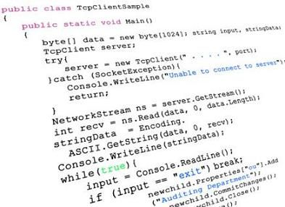

What is a computer program “as such” in the European Patent Convention?
Is this a computer program “as such”?
Is this also a computer program “as such”?

Slide 15
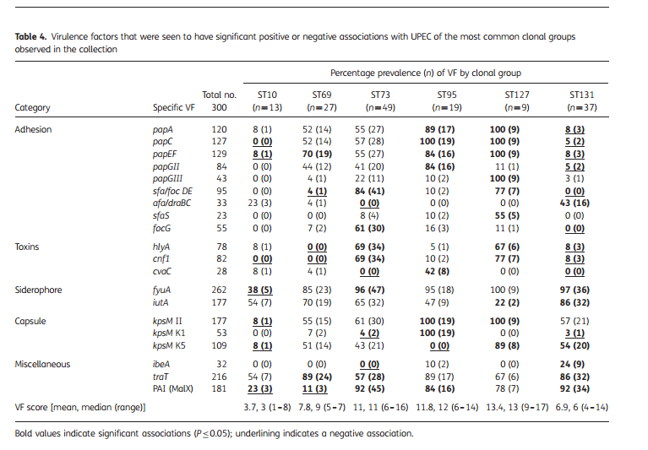

Disciplines with differing analytical tools
Unlike business students, lawyers do not tend to approach problems by experimentation or statistical analysis. Language is their primary tool.

Slide 16

IP as a subject in business schools: raising student awareness

Slide 17
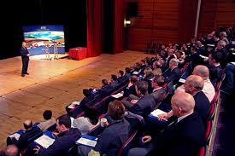
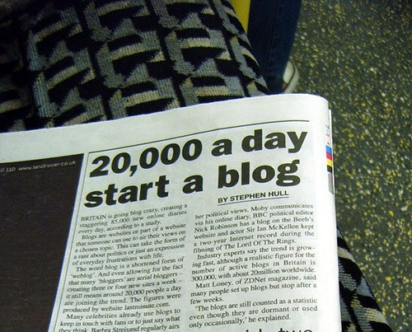
Mistake: public disclosure before filing
Conference speech
A blog

Slide 18
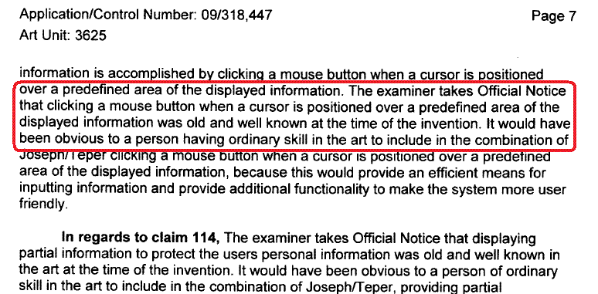
Mistake: drafting your own patent documentation
Failure to appreciate that the patent is not just a technical description of an invention; it is also a legal document. It has to be drafted with wording and phraseology that reflect the legal requirements. That requires special skill.

Slide 19
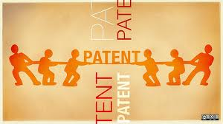
Mistake: the nature of a patent
Students are often surprised that the patent does not give the patent owner the right to use his/her invention. It only gives the right to exclude others from using that invention.
Underlying technology may be covered by someone else’s patent. A licence fee may have to be paid. Or that patent owner could refuse to grant a licence, using his patent to block development by others.

Slide 20

IP as a core subject in business schools

Slide 21

Any questions?

