Slide 1



Using an automated marking system to grade IP assignments ?
Peter van Dongenª, Richard De Mulder^{b} and Kees van Noortwijk^{b}
Netherlands Patent Office
Erasmus University Rotterdam, the Netherlands

Slide 2
Contents
Part 1; Peter van Dongen
Why is the NPO involved in IP teaching in The Netherlands?
A hands-on approach of IP teaching
Part 2; Richard De Mulder
Codas. The marking system to grade IP assignments

Slide 3
Peter van Dongen
IP advisor universities
Netherlands Patent Office (NPO)
EIPTN
Poitiers, 10-th of November 2018

Slide 4
Netherlands Patent Office (NPO)
A division within the Netherlands Enterprise Agency
NPO‘s ‘mission statement’:
An effective office for patent granting and registration, promoting the use of patent information and other IPR and a stepping stone for European and international IPR fora
Customers: SMEs, universities, spin-offs, start-ups, inventors

Slide 5
1. Background on IPR teaching
Task for the Ministry of Economic Affairs ?
Task for universities ?
'Innovation is important for the economy, and students are the next generation of managers, entrepreneurs, scientists and engineers'. So, …..

Slide 6
Factor | Societal impact of academic patents
 | Negative | Neutral | Limited | Considerable | Large
Scientists’ drivers impact of patent exploitation |  |  | Recognition | Research | Entrepre-neurship
University IP regime and patent use |  |  | EU optional services type Italian type | EU full services type Swedish type
University TTO governance and patent yield |  | Discipline-integrated | Autonomous, decentralised |  | Classical, centralised
Notes:
PhD research at VU Amsterdam

Slide 7
2. A hands-on approach of IP teaching a. Pro-active
65 000 students, 10 % in a roadmap for next 10 years b. Act on demand for CoE-s

Slide 8
New methods for IPR teaching?
MOOC and distance learning (EIPTN, 2017, Lund)
But:
Students, as human beings, also experience the psychological effect of 'Cognitive Dissonance'

Slide 9
Structured but diversified approach
Using standardised IPR assignments forms
1. Introduction IPRs for students all faculties
2. Introduction IPR databases
3. IPR drill ? ………

Slide 10
IPR drill ?
1. Identify a niche market and customers
2. Identify a societal or technical problem
3. Use papers with technologies/patents from your faculty staff to provide content and solve those problems or provide solutions for customers
4. Do you need IPRs to commercialise your solutions, if yes which ones
5. Submit the IPR check list, …..

Slide 11
The teachers‘ nightmare?
Grading the marks of the IPR assignments for
XXX students

Slide 12
Part 2; Prof Richard De Mulder

Slide 13

About us
Ask any teacher what they dislike most about their job, and they will probably say: grading exams and homework. Grading open question exams and essays takes an enormous amount of time! Is there a way to lighten that time consuming task, while maintaining quality grading? If we can lighten a teacher’s grading burden, then we free up more time for a teacher to deal with preparation and teaching.
Andromatics was founded by two academics: Professor Richard De Mulder and Dr Kees van Noortwijk. Both experienced university teachers, they wanted to find a way to help teachers grade papers more quickly. They have done so by means of the CODAS-software. Teachers retain control of the grading process; CODAS is their support system.
CODAS has been used by various educational institutions since the 1990s and has received excellent reviews. Apart from the reliability of the grading, this is partly due to the time-saving potential of the software and partly to the intuitive and user-friendly interface.
Number of exams | 25 | 50 | 100 | 200 | 500 | 1.000 | 2.000
Grading time required without Codas | 6,25 | 12,50 | 25 | 50 | 125 | 250 | 500
Grading time required with Codas | 6,25 | 7,25 | 8,25 | 9,25 | 10,25 | 12,75 | 16,75
Time saved | 0,00 | 5,25 | 16,75 | 40,75 | 114,75 | 237,25 | 483,25

Slide 14

Mission
Vision
To provide educational institutions with time saving software, enabling teachers to focus on that area where they make a difference: the transfer of knowledge and interaction with students.
Increasing teachers’ work satisfaction and students’ comprehension by giving teachers more time to prepare for class and interact with students.

Slide 15
Origin of Codas
Practical application of Codas in education
First version of Codas
Application of Codas outside the Erasmus university
Development of the grading-module
1989
1996
The first version of CODAS was designed for conceptual searches in legal databases. CODAS is based on a psychological learning model. The user teaches CODAS the concepts he/she wants to find and CODAS is then able to locate relevant material.
The first application of CODAS in the educational domain was as a fraud checker. Student exam answers and assignments were checked for similarities; pairs of answers were paired according to their similarity score. This led to the development of the fraud-module.
1995
1998 - present
Grading is essentially also a search for concepts. This led to the development of the grading-module.
CODAS is now used by various institutions in the Netherlands.

Slide 16
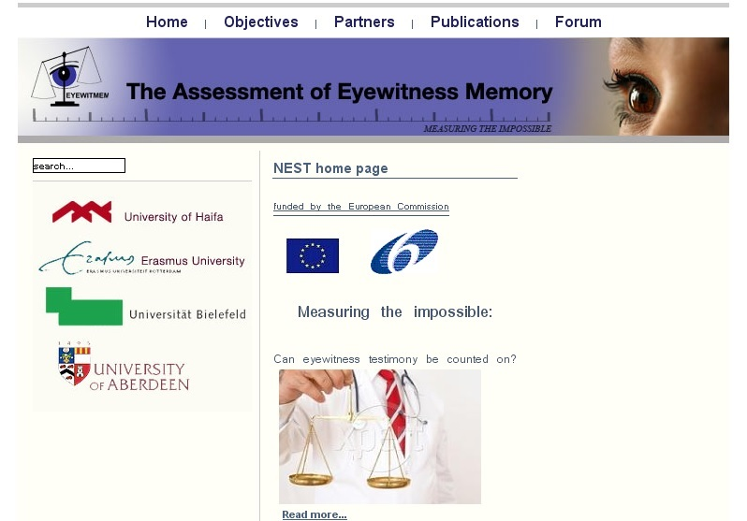

Slide 17
Features of Codas
Fraud detection
Grading
Monitoring
Mark:
- Assignments
- Exams with open questions
- Essays
Norm-comparison:
- between years x and y
- between different reviewers
Identify similar:
- Assignments
- Exams with open questions
- Essays

Slide 18
Fraud module
The fraud module provides quick and substantiated fraud detection. It does this by:
  Pairwise comparison
  Similarity scores
  Descending list

Slide 19
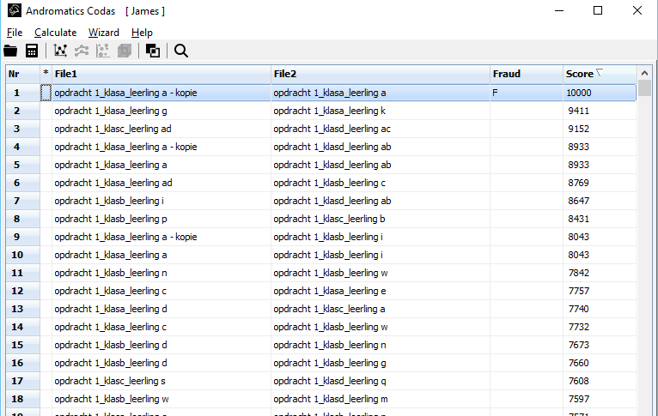
Fraud module
01
03
UNAMBIGUOUS
SUBSTANTIATED
It is immediately clear which assignments or exam answers are potential cases of fraud.
The potential fraud cases can be opened side by side to enabling a reviewer to verify their status.
02
04
USER FRIENDLY
QUICK
Potential fraud cases are directly recognizable by their high scores: they appear at the top of the list.
The fraud finder module instantly assesses the similarities between all the documents.

Slide 20
Fraud detection workflow
(STEP 1)
STEP 2
STEP 3
STEP 4
(Read in)
Calculate
Review salient cases
Determine fraud
Decide the file location of the documents.
Run the fraud module.
Based on the scores, decide which cases to compare side-by-side
Determine instances of fraud based on the scores and review of the documents

Slide 21
Grading module
The aim of the grading module is to speed up the grading of assignments, essays and open question exams. This is achieved by:
  Ordering of assignments, essays and exam answers based on scores
  Selecting a number of examples of good answers, ‘examples’, and bad answers, ‘counter-examples’ (input teacher)
  An iterative process

Slide 22
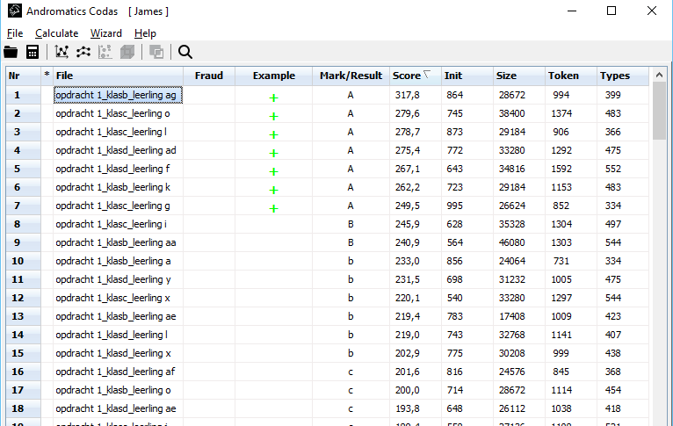

Grading module
01
03
SIMPLE
CONTROL
The assignments at the top of the list are likely to be the best and those at the bottom are likely to be the worst.
During the process the teacher has complete control. CODAS aids the teacher, but it is the teacher who determines the grading criteria and reviews the results.
02
04
STRUCTURED
EFFICIENT
The software shows the teacher which documents have been manually reviewed, and which have been automatically reviewed.
Hundreds of grading hours can be saved each year by using the CODAS software.

Slide 23
Grading workflow
(STEP 1)
STEP 2
STEP 3
STEP 4
(Read in)
Calculate
Decide on examples and counter-examples
Grade
Decide the file location of the documents.
Calculate the scores. First the initial scores, later the final scores.
Decide which assignments are examples of good answers and which are examples of poor answers.
Repeat steps two and three until satisfied with the results. The results can be saved in an excel-format.

Slide 24
Monitoring
The aim of monitoring is to compare assessments of assignments, essays and exam answers:
  Within a group – to identify outliers
  Between groups – to compare assessements
    from year to year
    from group to group
    between assessors.

Slide 25
Key features of Codas
REVOLUTIONARY
EFFECTIVE
EFFICIENT
CODAS enables users to grade open question exams and essays.
CODAS gives teachers the room to focus their efforts on teaching and knowledge transfer.
CODAS enables teachers to test the comprehension of their students more often, without additional grading time.
TIME SAVING
FAIR
INTUITIVE
CODAS saves huge amounts of grading time, especially with larger classes or groups.
CODAS makes it possible to avoid discrepancies and differences in the way assessments are done.
CODAS is user friendly and easy to use.

Slide 26
Recent developments
  Use a randomly selected set of 100+ marked assignments to determine whether Codas could predict scores, and with which accuracy
  A webservice for teachers to upload assignments to be marked on the basis of previous assessments.
  To compute marks on parts or aspects of assignments in order to be able to provide feedback to students.
Notes:
o

Slide 27
Thank you for your attention !
Peter.vandongen@rvo.nl
Netherlands Patent Office
R.demulder@Andromatics.nl
Andromatics®B.V.
Erasmus University Rotterdam

