Slide 1
Stages in an IP Educator’s career
Professor Ruth Soetendorp
CIPPM Bournemouth University
Cass Business School City University of London

Slide 2


Slide 3
Early days - In the beginning
Why choose Intellectual Property?
Why choose Academe?
Why choose IP Education
An IP educator’s career probably begins with offering to research and teach IP Law
But where does it end?

Slide 4
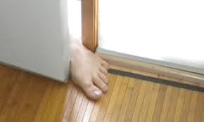
‘Foot in the Door’ opportunities
Opportunities arose in my own back yard….
Enterprise challenges: students need IP advice
University’s IP policy needs revision
Trade Union - advice on staff IP rights
Interdisciplinary research funding leads to cross faculty work

Slide 5
‘Foot in the door’ we all have a tale
How did I expect to make my entry level appointment?
What early stage compromises did I make to progress?
How did my academic career begin at Bournemouth University?

Slide 6
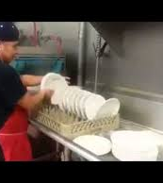
‘Foot in the door’ benefits
Choose WHERE you want to work, take any job, knowing that your worth will be spotted
Rather than wait for THE job to present
Be confident in what is the best choice for you

Slide 7
‘never say no to an opportunity’
You don’t know where it will lead
Union involvement led me to develop a good relationship with University senior management
Pursue a niche interest, even if others rubbish it…. e.g. researching student attitudes to IP with UK NUS
Accept tasks for which you feel ill prepared…seeking answers can develop links that help your knowledge grow
Make friends outside your comfort zone, outside your faculty

Slide 8
Mid career
My confidence began to grow
Began to recognise my strengths, and weaknesses
Started taking responsibility at work, and in related organisations
My ideas were becoming known and respected among peers, through publishing and presenting at conferences
My students were beginning to make careers of their own

Slide 9

“Should I stay or Should I go?”
The Clash, 1981
The world’s your oyster
Take the risk?
Follow your dream?
If not now, when?

Slide 10
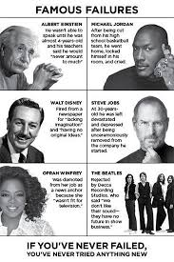

Coping with Rejection
Some of my rejections:
Applied 3 times for an established post
Applied twice to be an Established Chair
Challenged a Leverhulme Trust Funding decision

Slide 11
All the worlds an (academic) stage
JAQUES: All the world's a stage,
And all the men and women merely players;
They have their exits and their entrances,
And one man in his time plays many parts,
His acts being seven ages. At first, the infant,
Mewling and puking in the nurse's arms.
Then the whining schoolboy, with his satchel
And shining morning face, creeping like a snail
Unwillingly to school. And then the lover,
Sighing like a furnace, with a woeful ballad
Made to his mistress' eyebrow. Then a soldier,
Full of strange oaths and bearded like the pard,
Jealous in honor, sudden and quick in quarrel,
Seeking the bubble reputation
Even in the cannon's mouth. And then the justice,
In fair round belly with good capon lined,
With eyes severe and beard of formal cut,
Full of wise saws and modern instances;
And so he plays his part. The sixth age shifts
Into the lean and slippered pantaloon,
With spectacles on nose and pouch on side;
His youthful hose, well saved, a world too wide
For his shrunk shank, and his big manly voice,
Turning again toward childish treble, pipes
And whistles in his sound. Last scene of all,
That ends this strange eventful history,
Is second childishness and mere oblivion,
Sans teeth, sans eyes, sans taste, sans everything.
As You like it,
William Shakespeare
The sixth age shifts
Into the lean and slippered pantaloon,
With spectacles on nose and pouch on side;
His youthful hose, well saved, a world too wide
For his shrunk shank, and his big manly voice,
Turning again toward childish treble, pipes
And whistles in his sound.

Slide 12
When does the (IP) past begin?
Legally, we endeavor to be up to the minute with regard to the latest legislation and decisions.
At the same time, we pay respect to ancient decisions that underpin current legal thinking.
We encourage students to do likewise

Slide 13
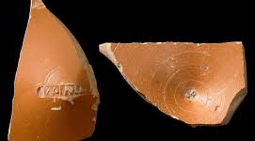
Ancient Legal IP is acceptable

Slide 14

The past is a foreign country….
“The past is a foreign country, they do things differently there”
L. P Hartley, The Go Between 1953
What does that mean in the latter stages of your career?

Slide 15
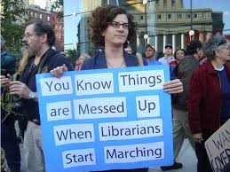
Ancient Cultural IP
Cultural references can become rapidly unacceptable
Academic year on year, check your cultural references, before your students check them for you.
Impact on legislators, like other fashions, changes fast.

Slide 16
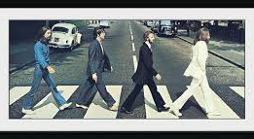
International Cultural IP examples

Slide 17

Whatevs……*
Where does Ancient Cultural IP begin?
1951: The Man in the White Suit
Music is more transitory.
I used to use Bjork to illustrate the importance of keeping good records when collaborating
Not any more. This year the students suggested I use Taylor Swift!

Slide 18
When to Retire?
Timing my retirement was a personal decision
It was triggered by wanting to:
return to London
benefit from a University redundancy deal
Continue ‘Working’ but NOT wanting another ‘Job’ (subtle difference)

Slide 19
Working Life after Retirement
Mine has included a number of invitations:
To take short term contracts covering absences - felt at times like the IP ‘A Team’
To act as an external examiner, sit on committees, business panels, attend IP education conferences, at home and abroad
To write for publication
To join research projects

Slide 20
Current IP education - teaching
I agreed to teach Introduction to Business Law on BSc management degree at City UoL
Which led to design and delivery of an u/grad IP management module on Bsc Management
Which led to design and delivery of a p/grad IP management module on City’s Masters in Innovation, Technology and Leadership
Which involves me in an Arts Council England Boosting Resilience research project

Slide 21
Current IP Education developments
Offering IP Education in the innovative and creative, arts and culture sectors
Promoting an approach to IP Education that focuses more on equipping students to ask questions than providing them with answers
Drawing on earlier work that highlighted the importance of embracing ignorance in professional education

Slide 22
Looking forward – short term
Leading the ACE Boosting Resilience for the New Normal Residential workshop
Presenting to the Centre for IP Understanding IP Awareness Summit, NYC
Welcoming publication of the UKIPO Research into Designs Infringement report
Assessment Marking… assessment marking… assessment marking

Slide 23

Looking forward long term to…
Receiving invitations to do interesting things
Having something innovative and interesting to offer to EIPTN 2019
Reading about your innovations from the IP Education community

Slide 24
Thank you

