Slide 1


Teaching trademark law through digital quizzes
Vicente Gimeno Beviá

Slide 2
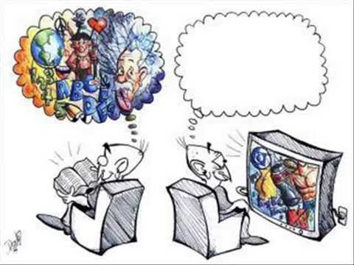
From the homo sapiens to the homo videns
Books, imagination, concepts
TV, internet, smartphones→ image

Slide 3


Every baby comes with a loaf of bread under his arm

Slide 4
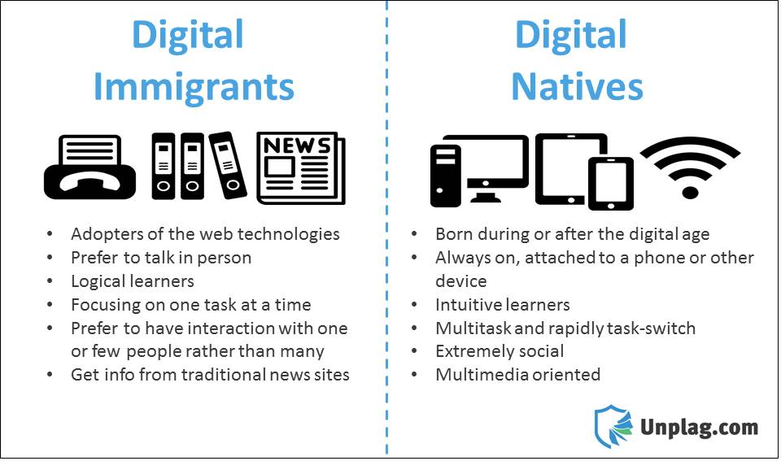
Law students are digital natives

Slide 5





A picture is worth a thousand words
The images are essential for teaching Trademark Law

Slide 6



Quiz programs
E- LEARNING

Slide 7

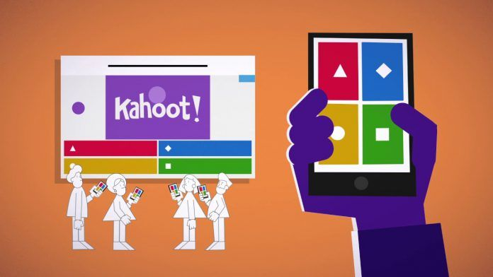
30 million users around the world
Notes:
.

Slide 8
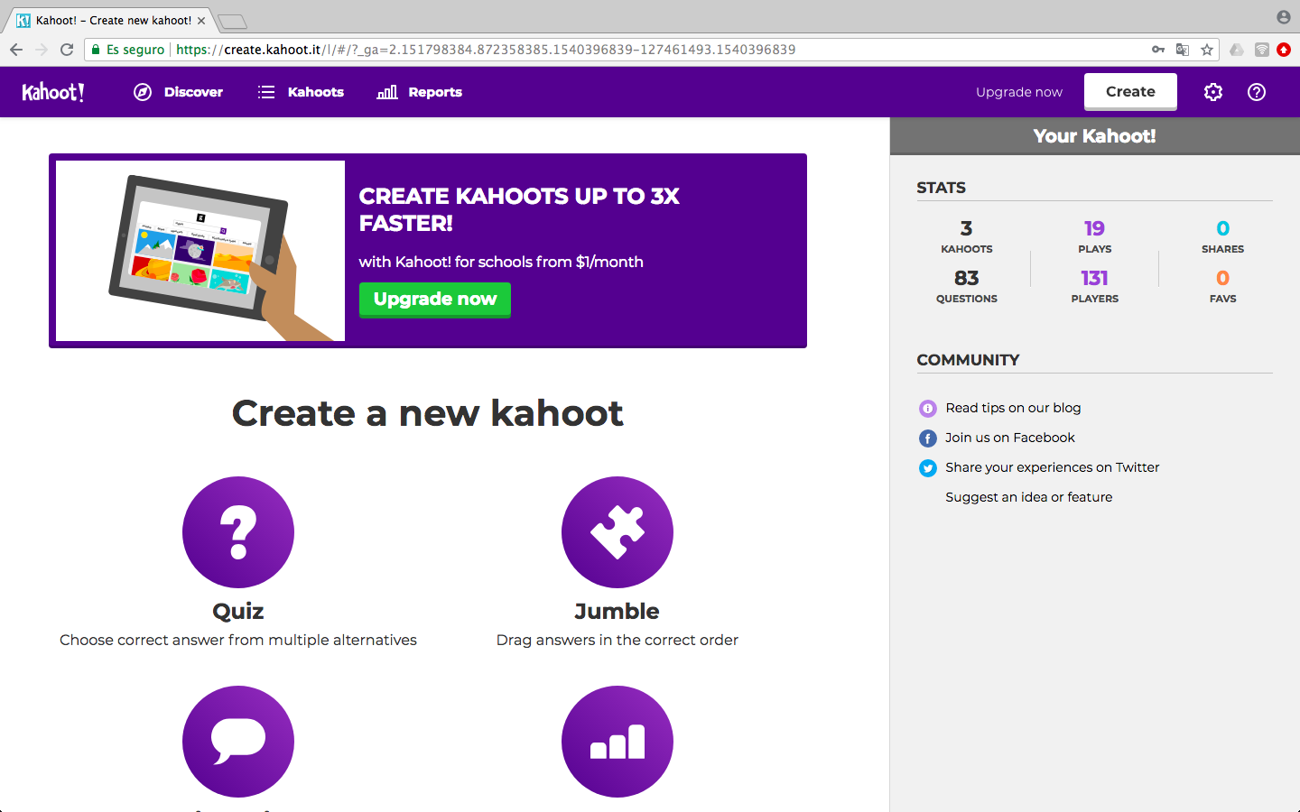
Kahoot! options

Slide 9
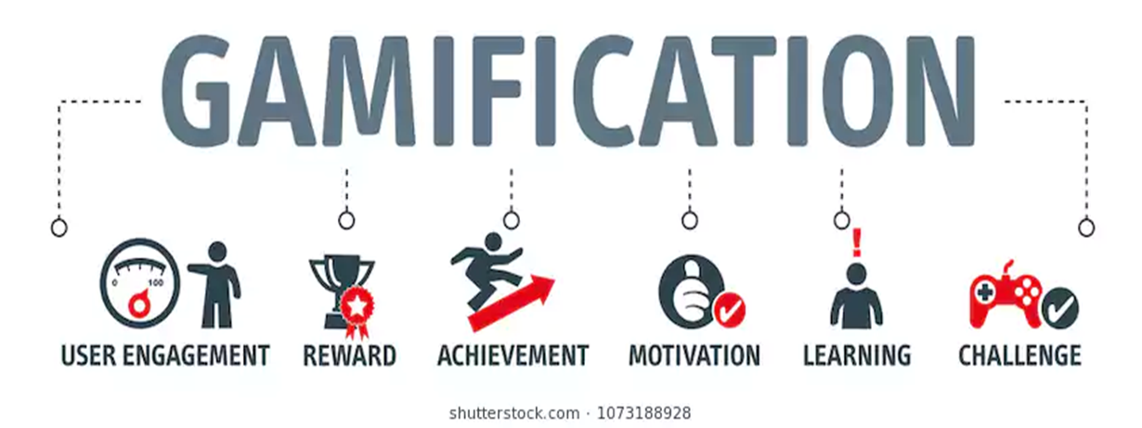

Slide 10


How the platform works
1. Under the teacher point of view
II. From the students side

Slide 11
I. Teacher www.kahoot.com

Slide 12
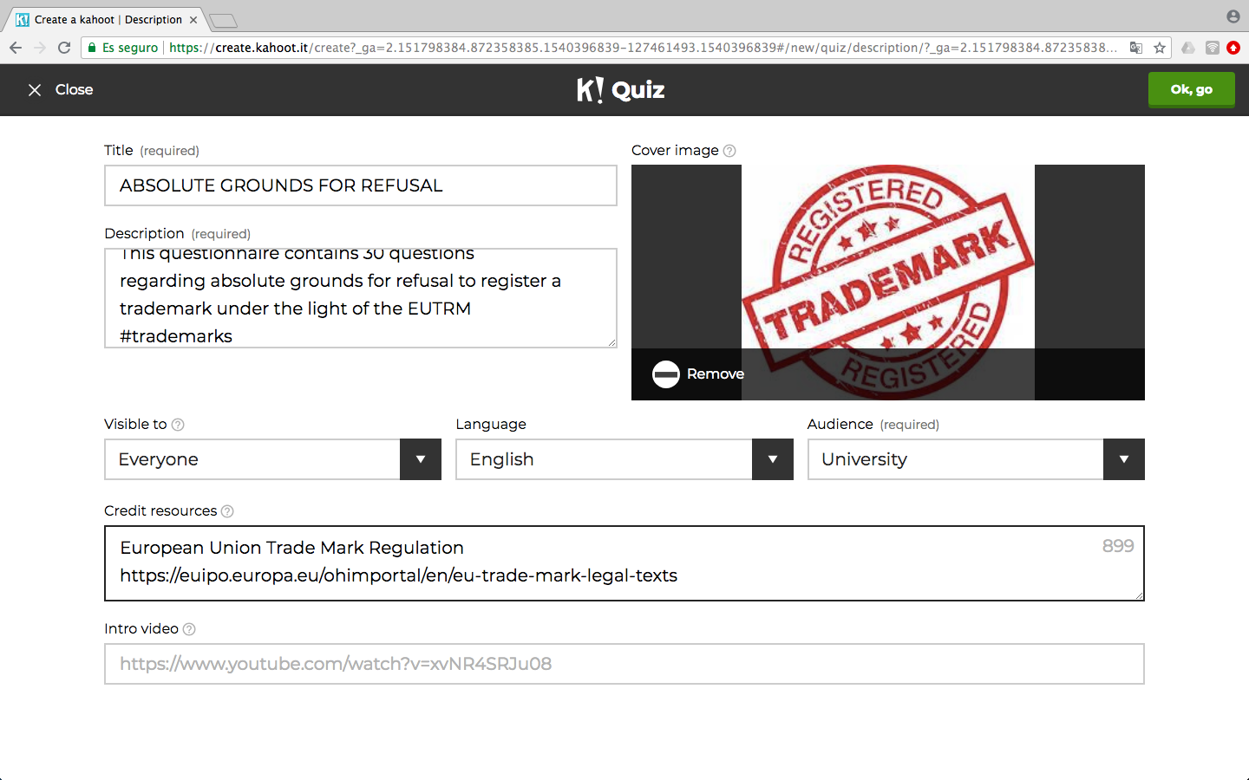

Slide 13
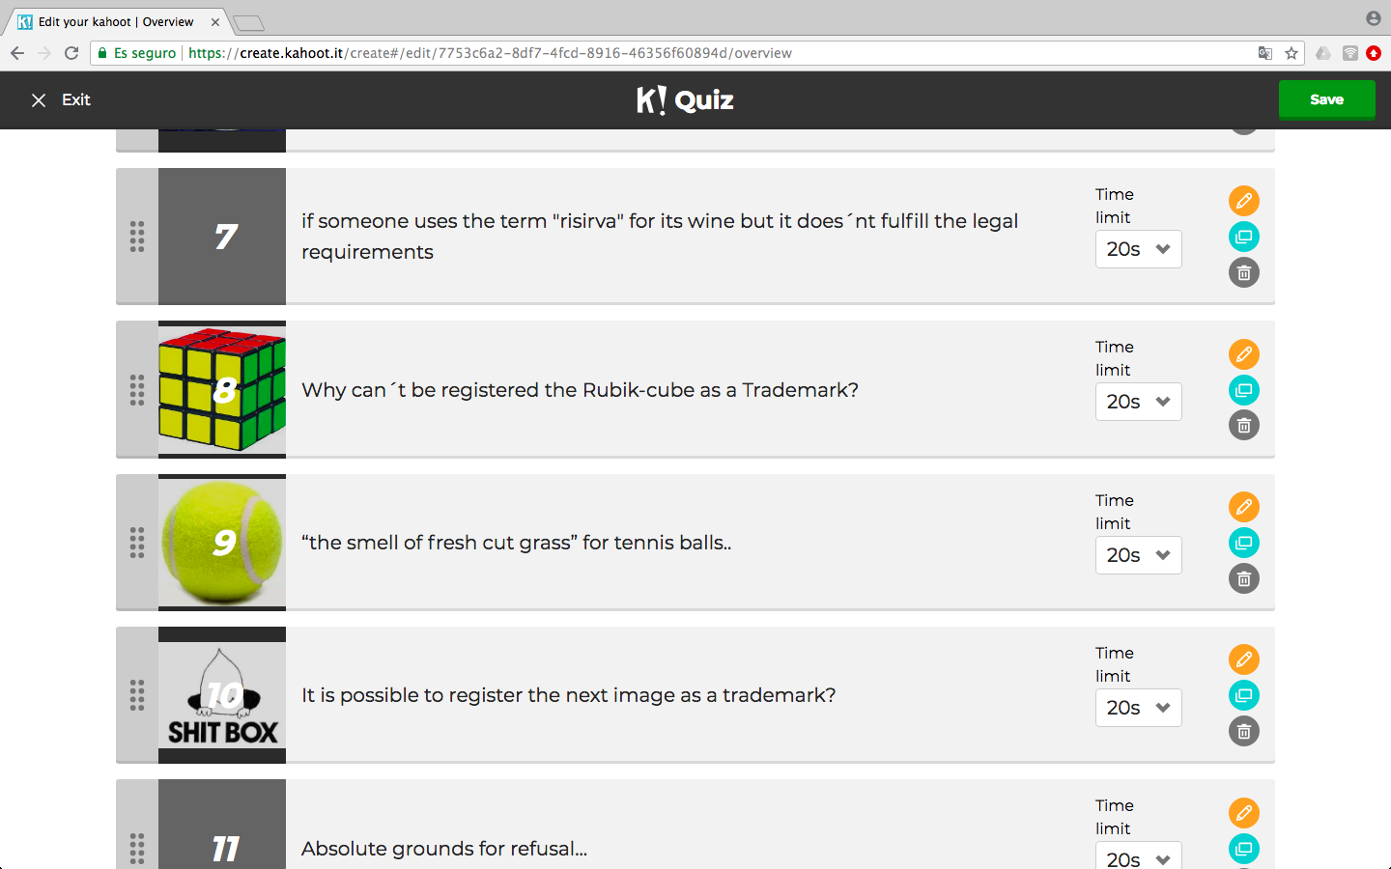
Preparing the questionnaire

Slide 14
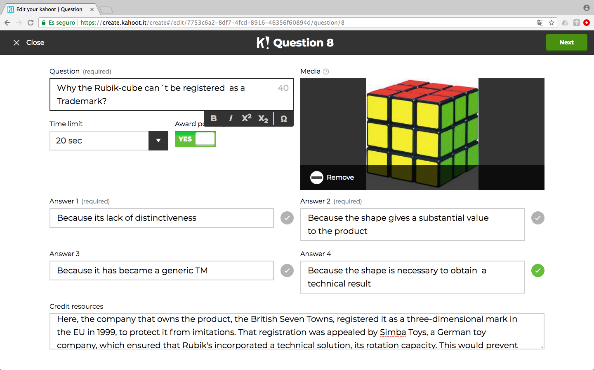
Writing the question

Slide 15
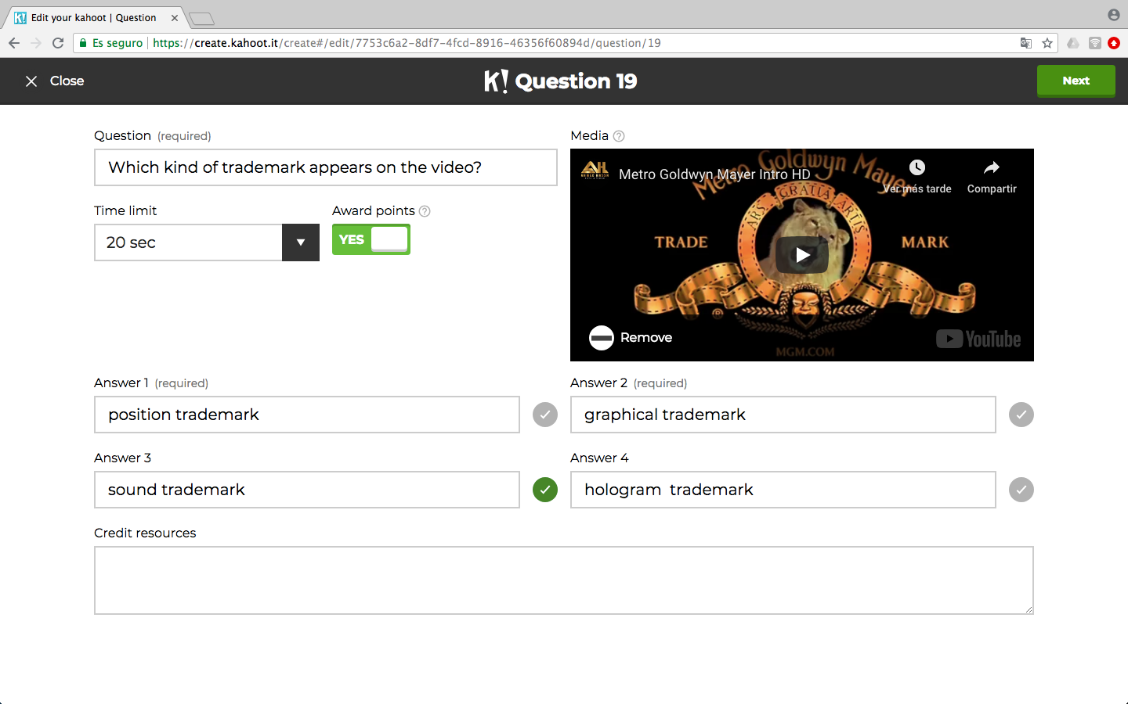
Adding images or videos

Slide 16
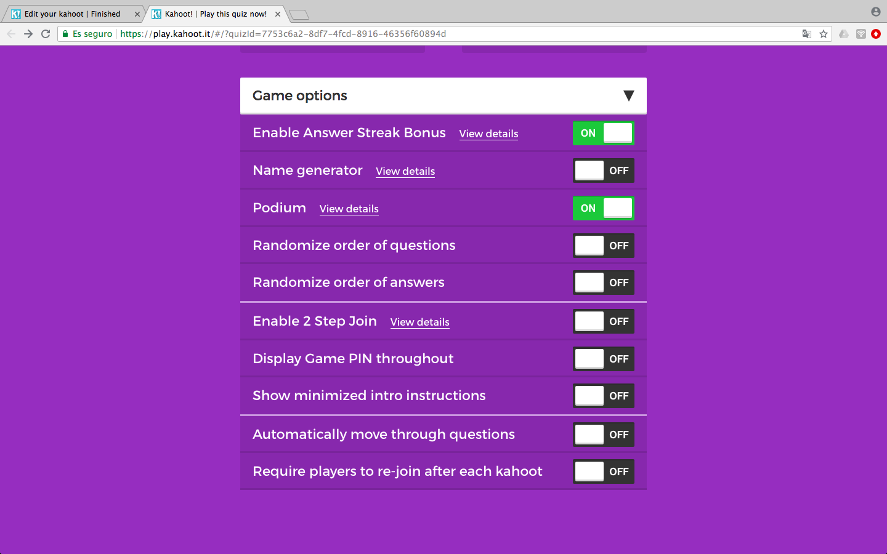
Settle the game options

Slide 17
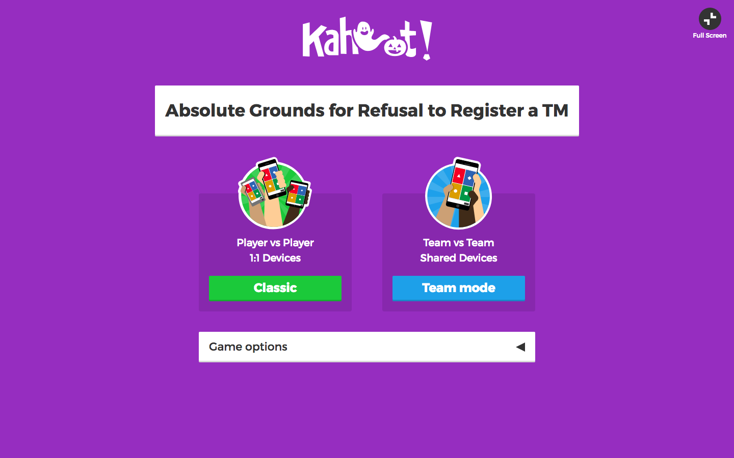
Classic or team mode

Slide 18

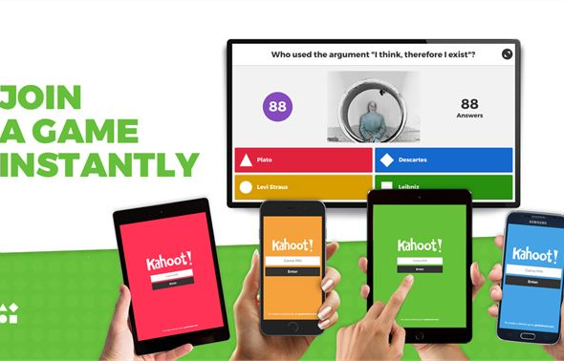
Students www.kahoot.it

Slide 19
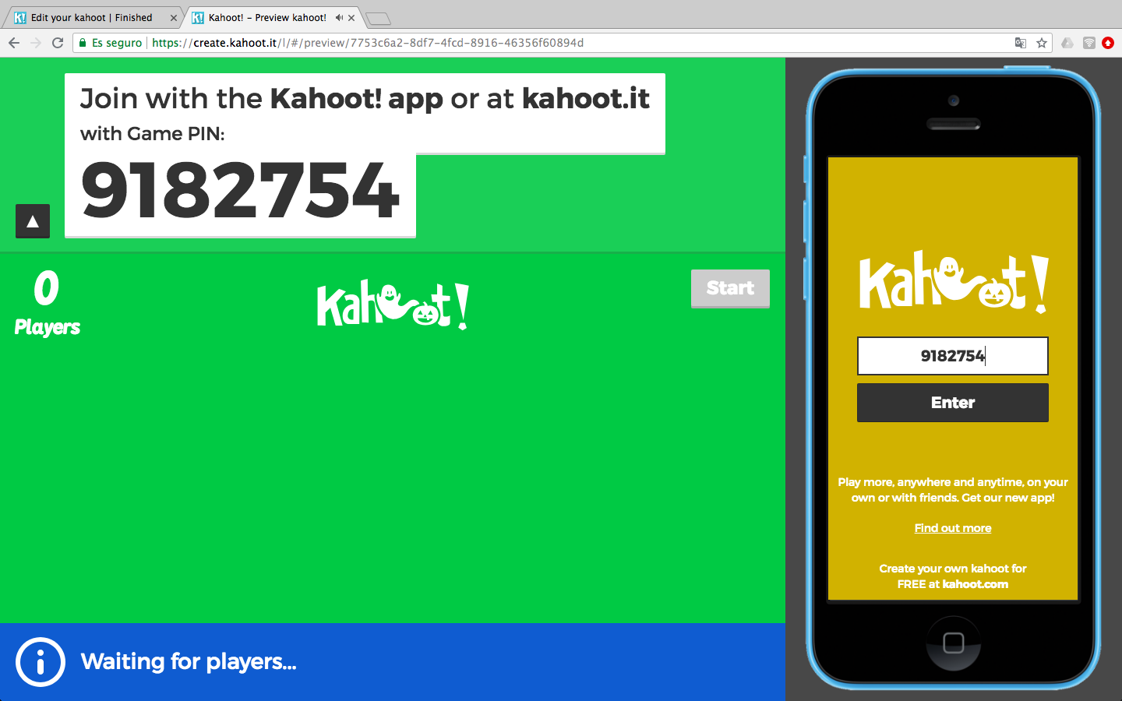
Game PIN

Slide 20
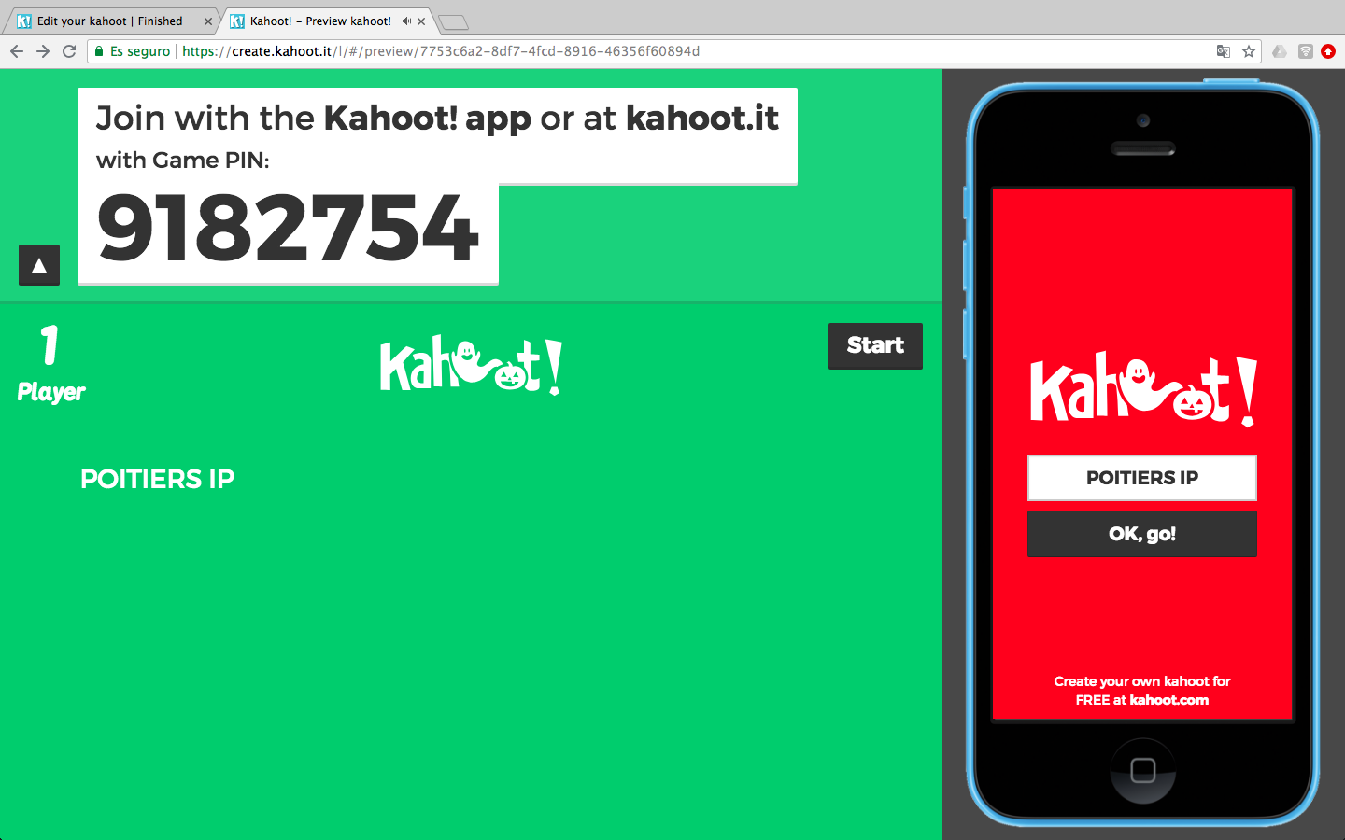
Real or fantasy nickname

Slide 21
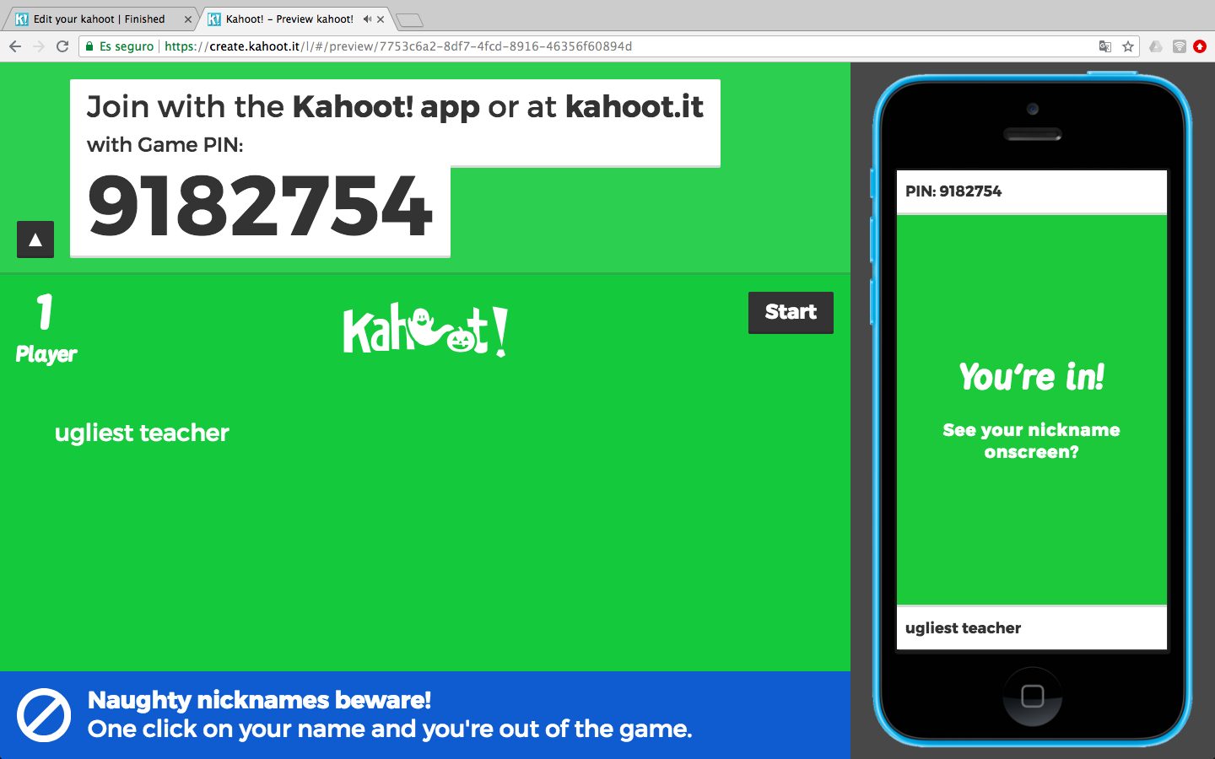
Naughty nicknames are not welcome

Slide 22
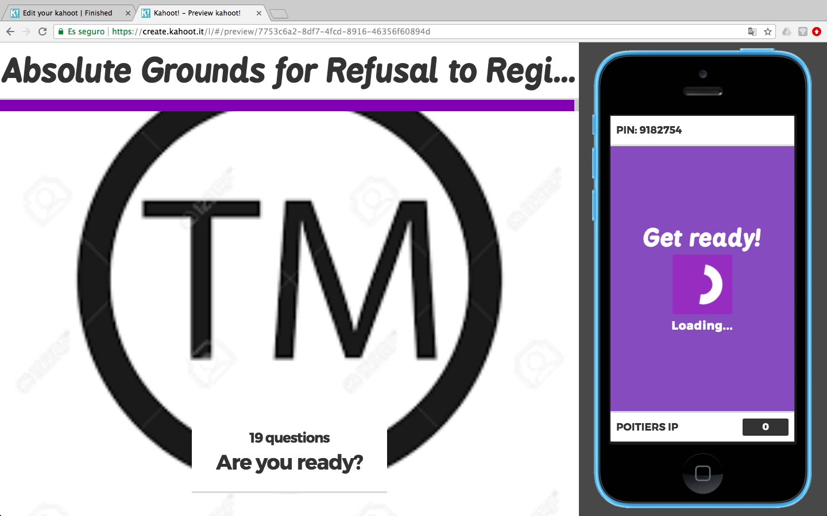
Ready to play

Slide 23
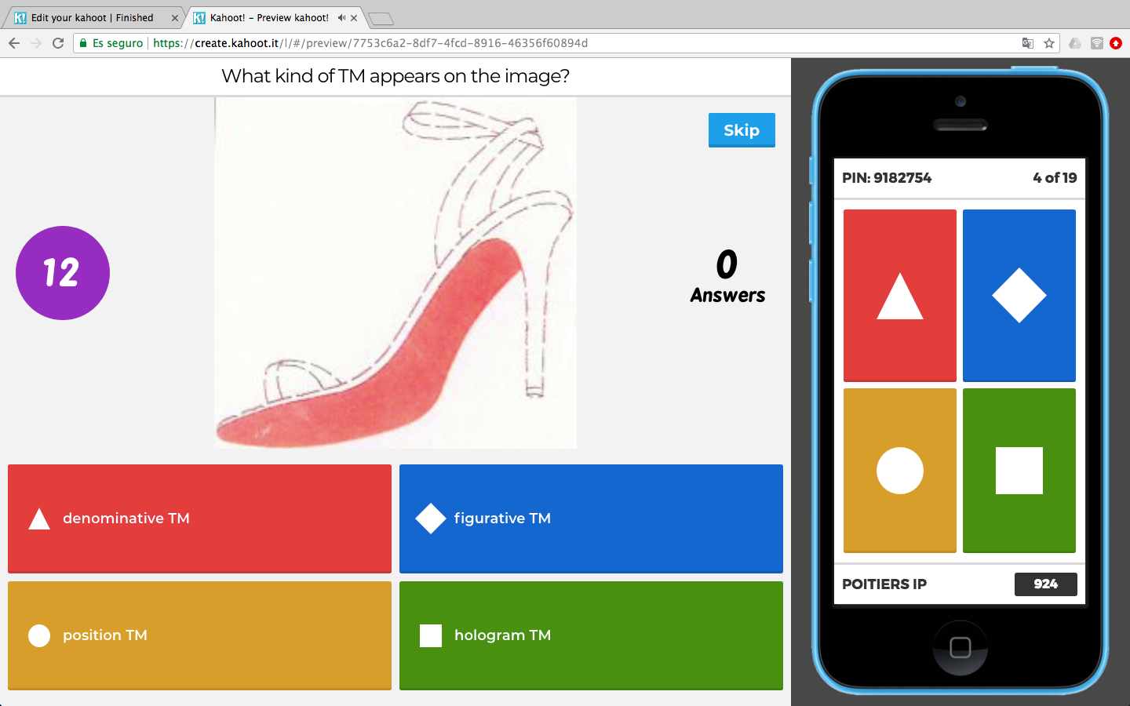
Multiple choice

Slide 24
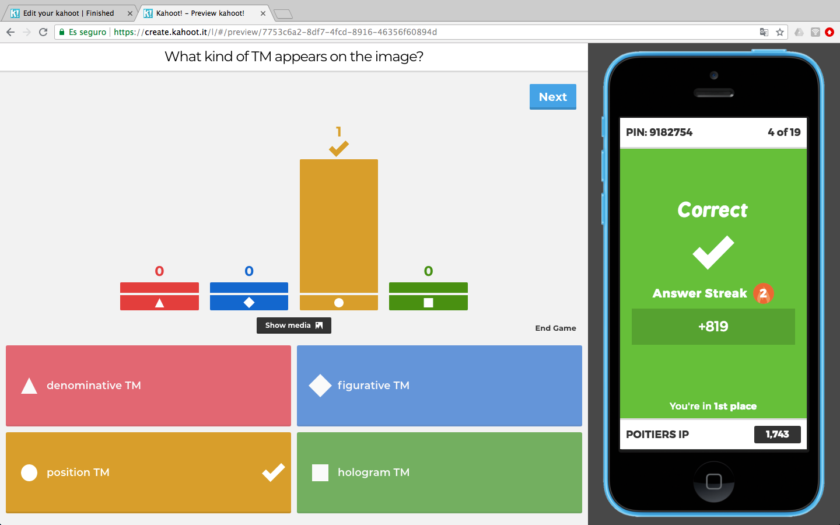
Question statistics

Slide 25
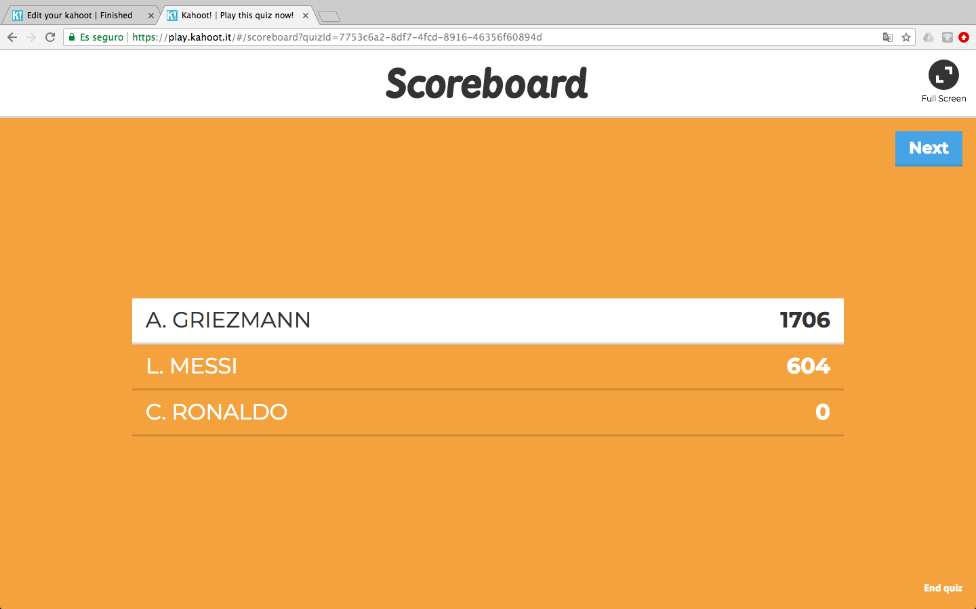
Provisional ranking

Slide 26
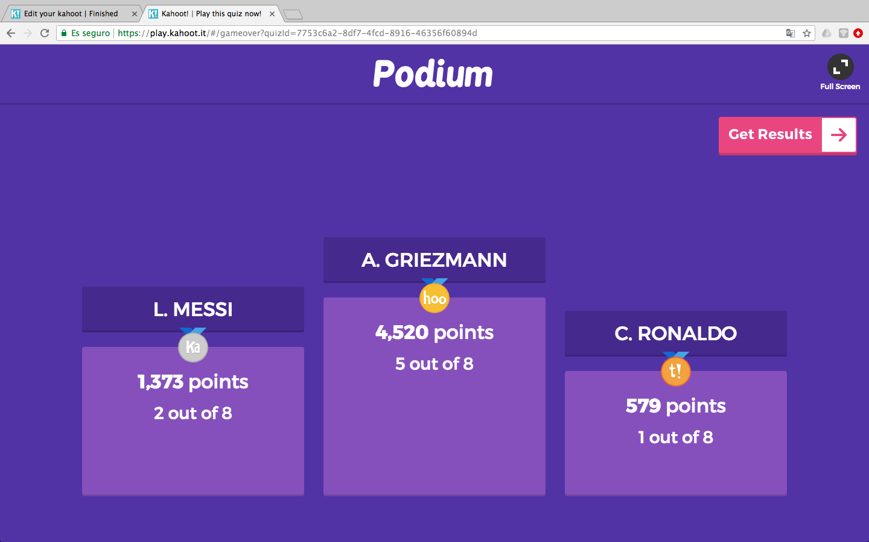
Final ranking

Slide 27
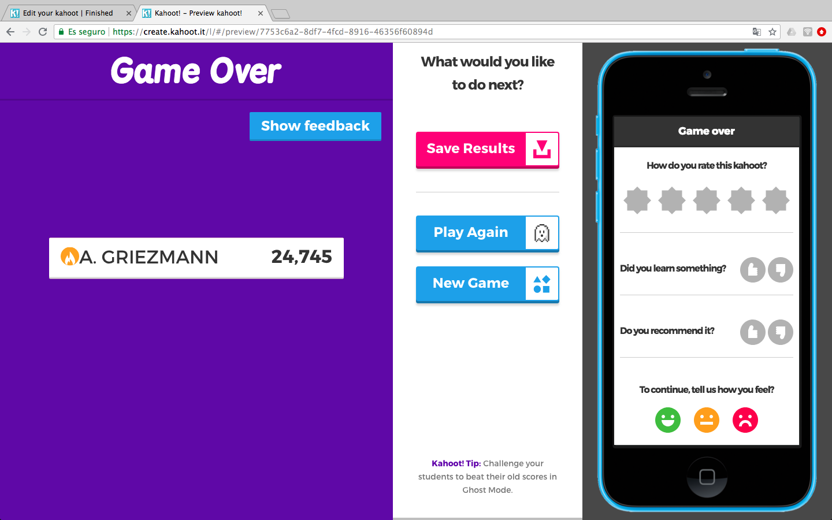
Each student marks the Kahoot!

Slide 28
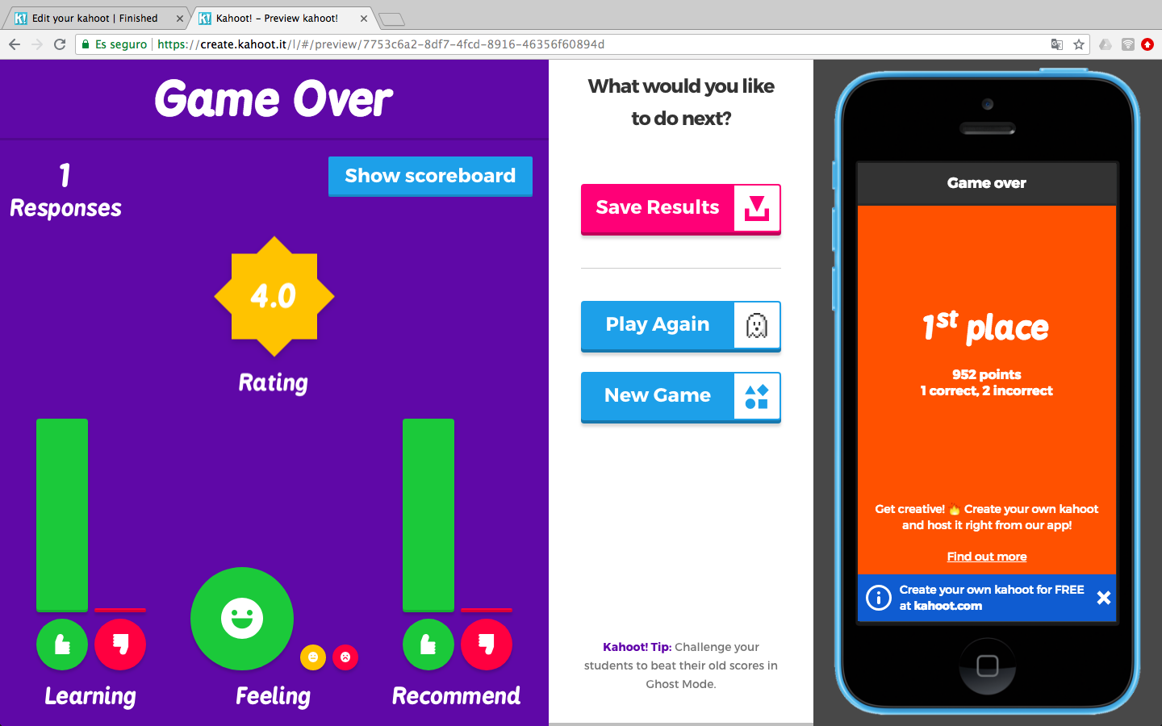
Students feedback

Slide 29
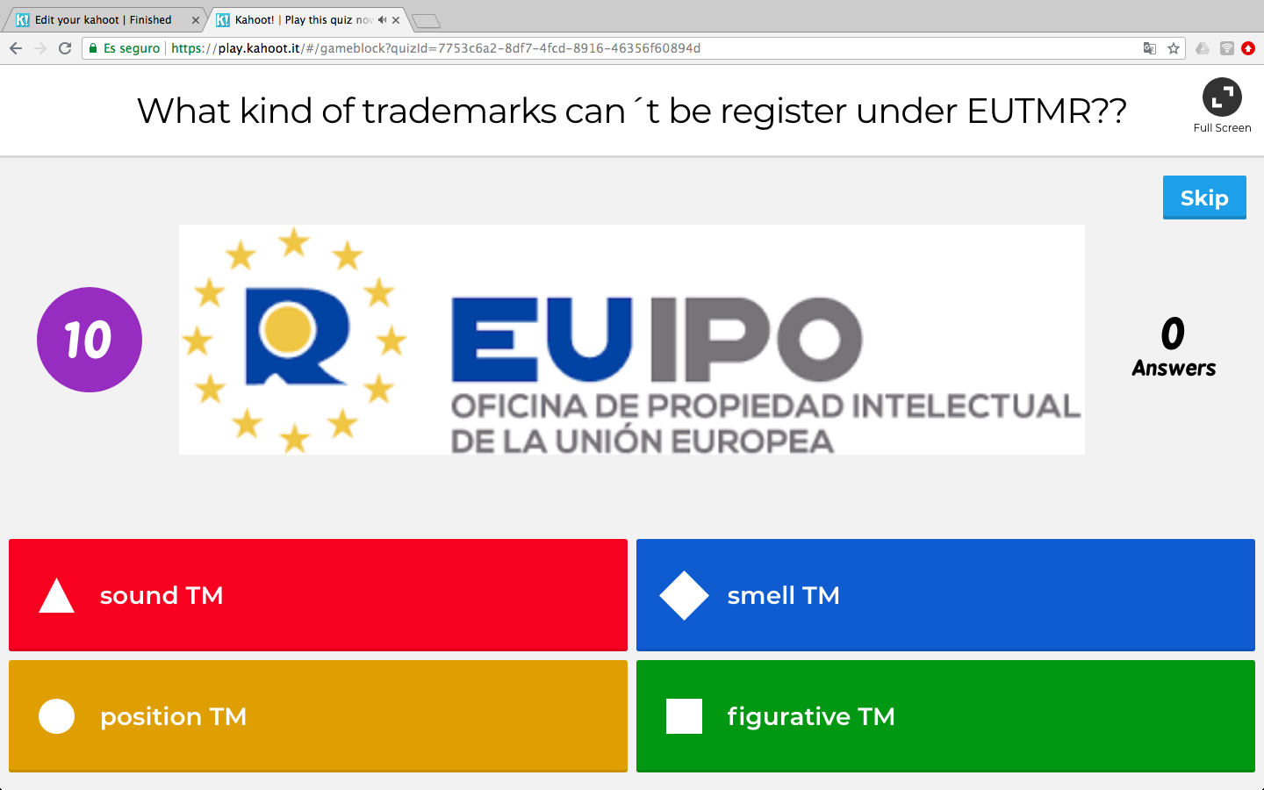
Examples TM law questions

Slide 30
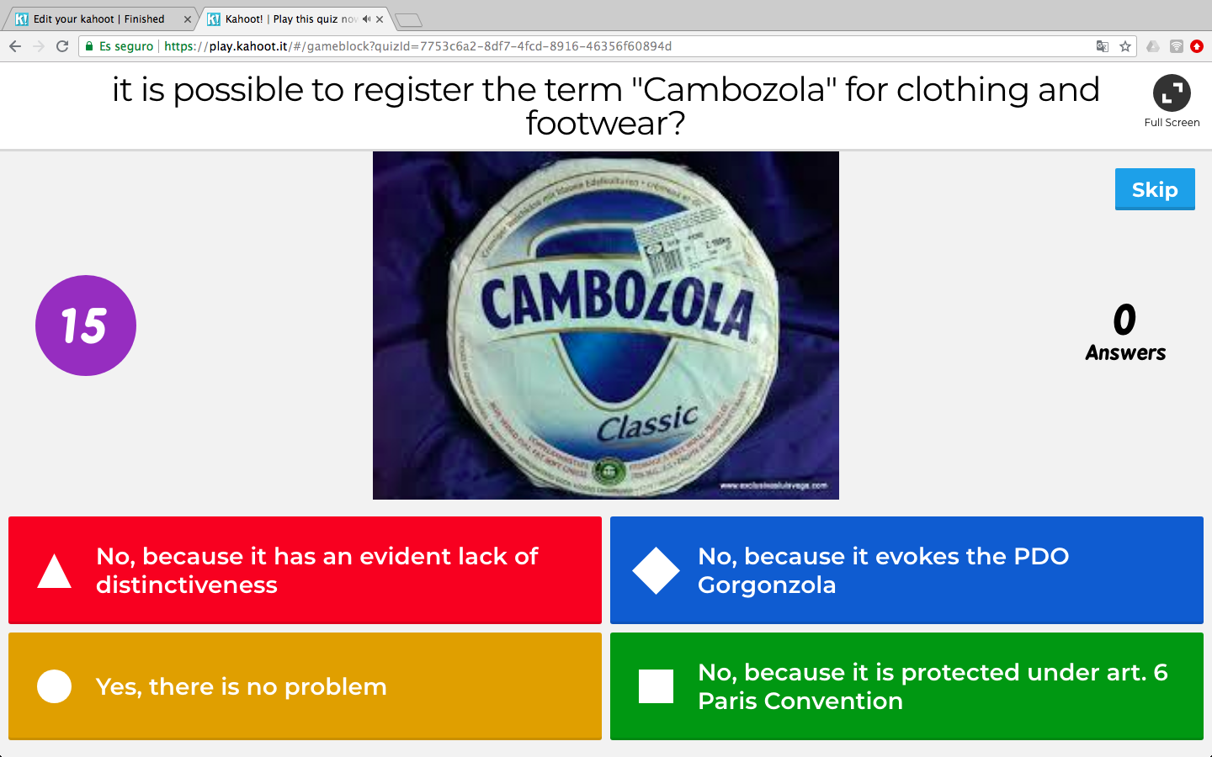

Slide 31
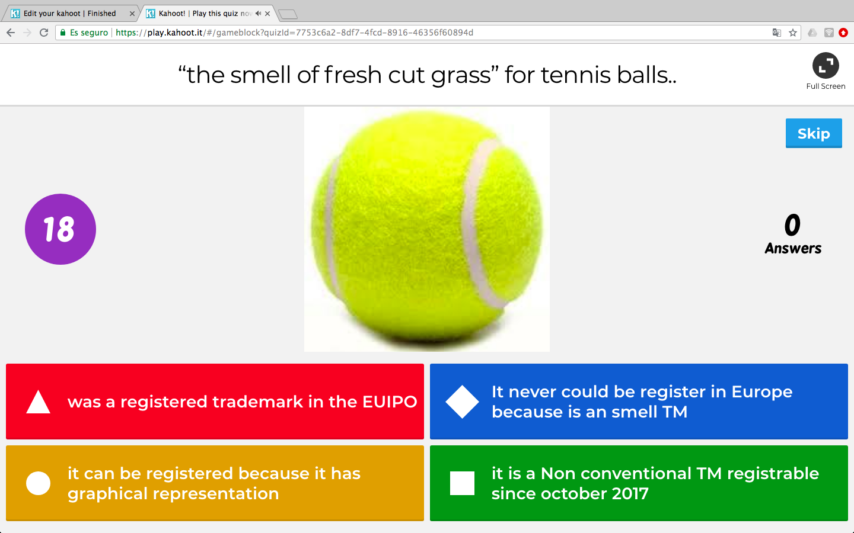

Slide 32
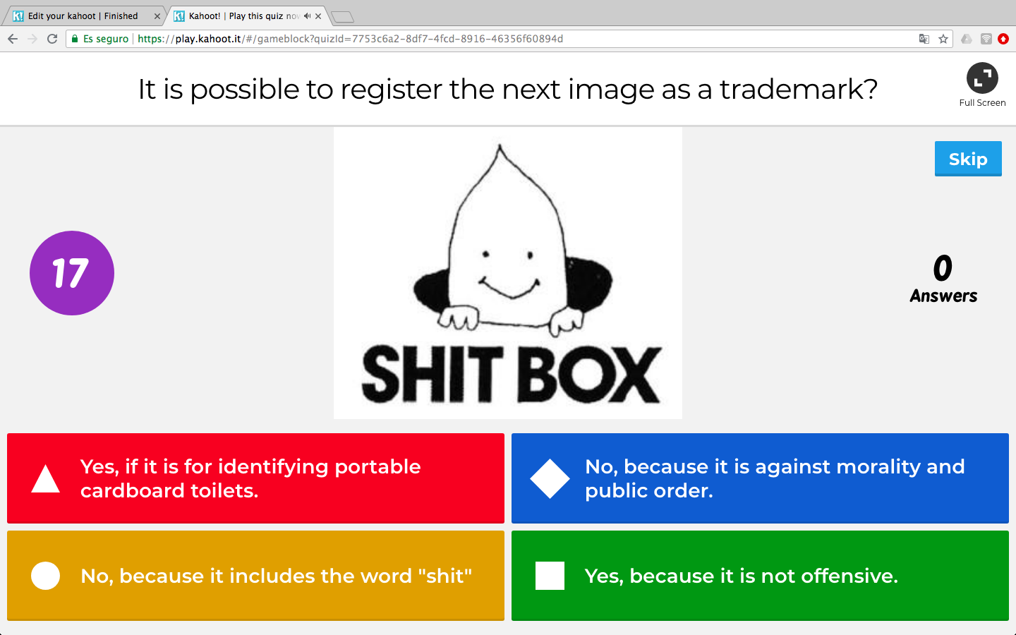

Slide 33
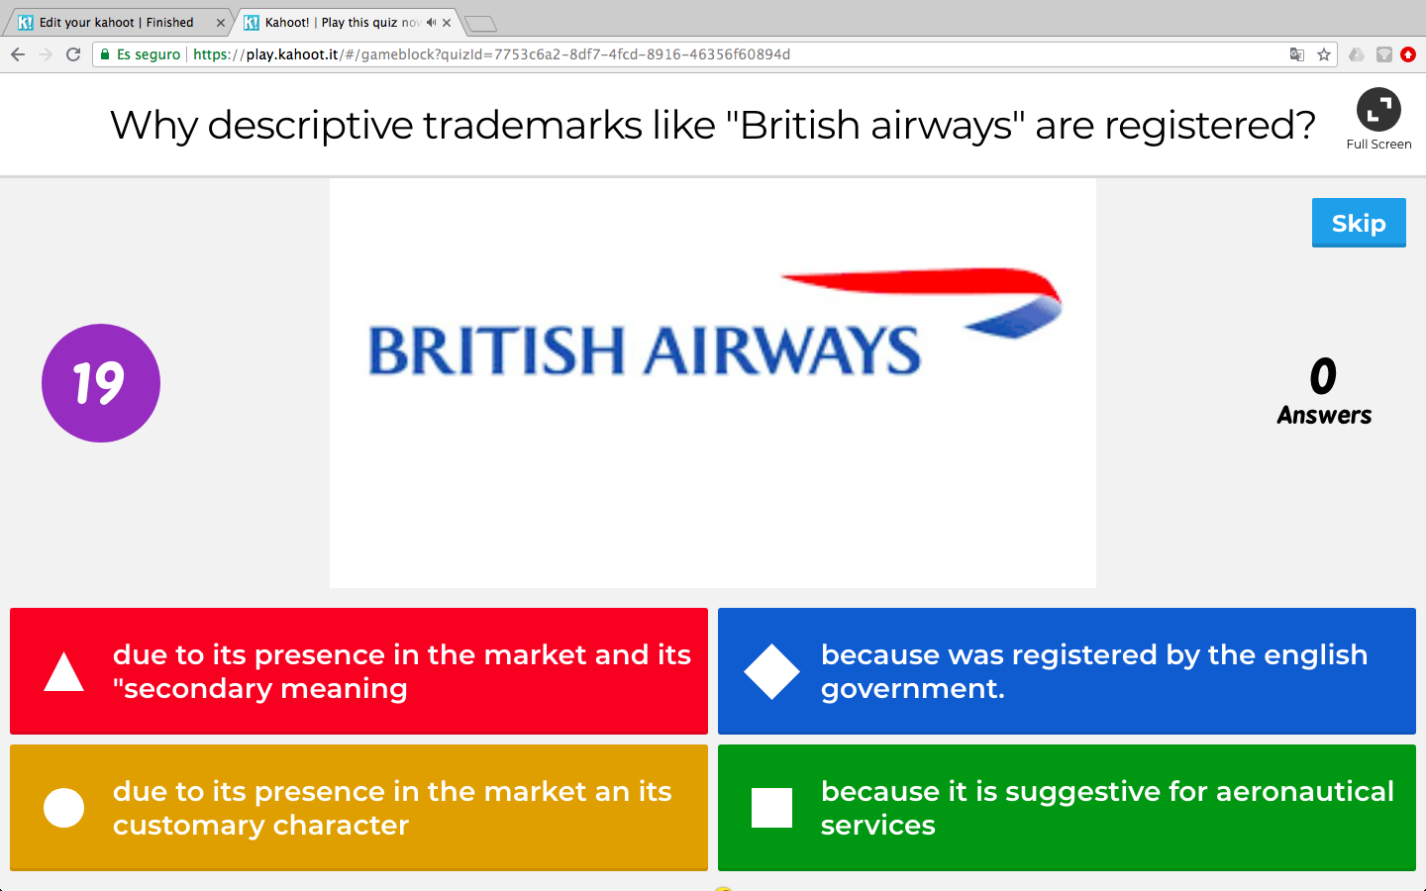
Notes:
Other example of descriptive trademarks..

Slide 34
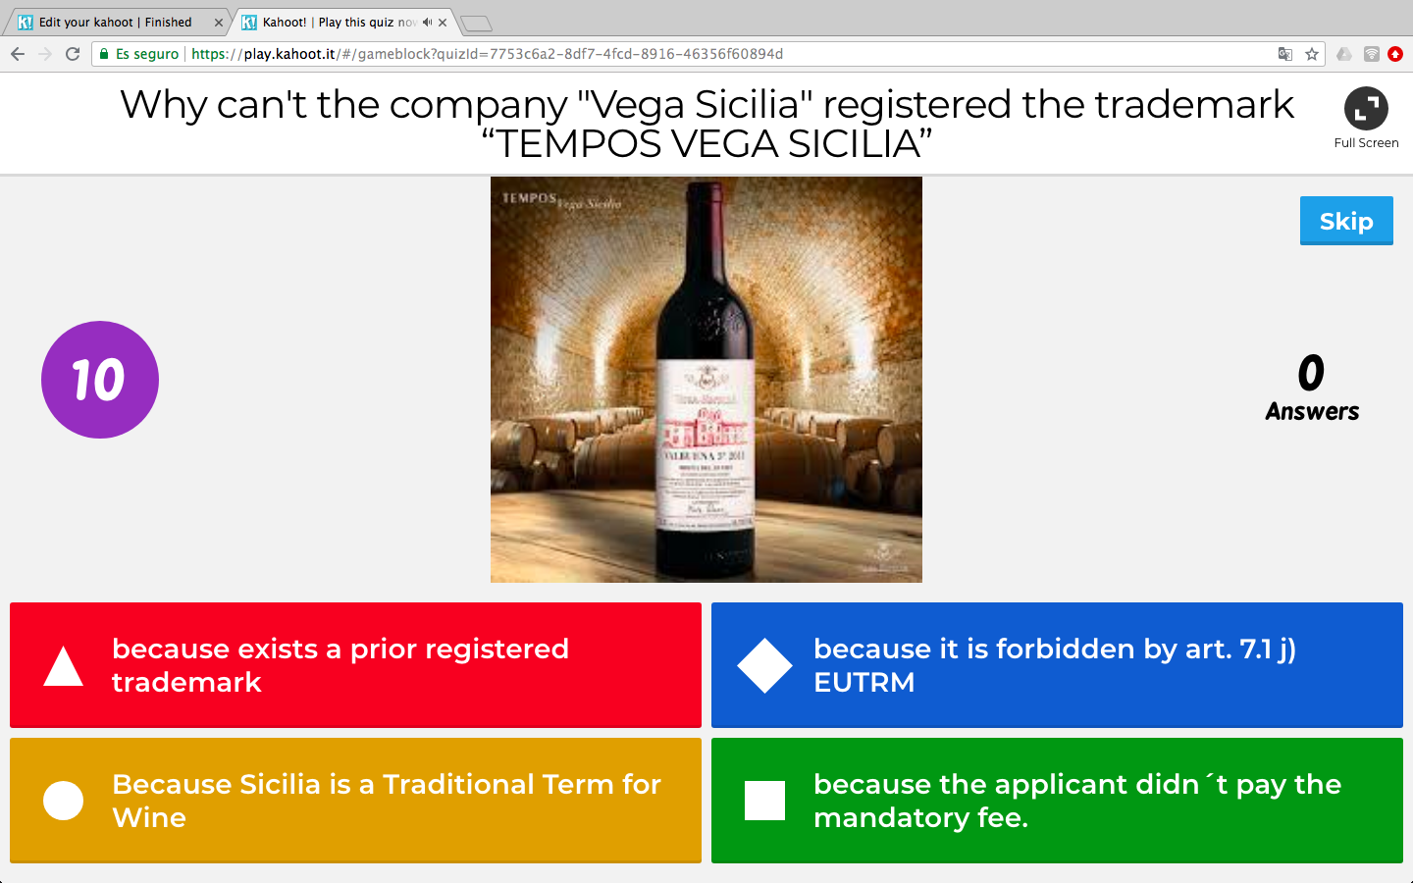
Notes:
One of the best wines of Spain in Ribera del Duero.

Slide 35
Kahoot! Advantatges
Increases students attention
Encourages students participation
Finding out the level of the students
Controlling class attendance
Tailoring a quiz for special events
Notes:
To summarize there are many advantages linked with the use of this platform:
1st. Increases student attention due to its agile and enjoyable format.
2nd. Encourages student participation thanks to the contest system and the possibility of answering in an anonymous way.
3rd. Facilitates the monitoring of students and allows to figure out the level of the class and its evolution.
4th. It is a really useful tool for controlling class attendance and really useful in this continuous evaluation inherent to the Bologna Plan.
5th. And due to its flexibility you can tailor a quiz for special events. For example when you are a visiting professor in a teaching staff it is a fantastic occasion for preparing it. Last year I had a teaching staff in Sicily and I did a kahoot with questions regarding Parmesan cheese, the dispute between Cambozola and Gorgonzola or, for example, if the trinacria flag could be registered as a TM.

Slide 36
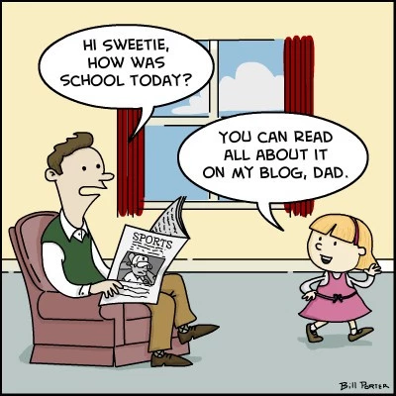
Times are changing…
Notes:
In conclusion, as Bob Dylan sang, “times are changing” we should rethink the way of teaching IP because the students learning process is very different from ours. So we should promote new tools like digital quizzes and teach IP being as graphical as possible because I am convinced that it is a really valuable way to stimulate IP students.

Slide 37


Vicente Gimeno Beviá
vicente.gimeno@ua.es

