Slide 1

Innovations in Teaching in Intellectual Property
Dr Maureen O’Sullivan
PhD (University of Edinburgh); LLM (Warwick); PGCHE (UWE, Bristol) BA and BCL (UCC)
And
Marianne Walsh
BCL and Business (Maynooth University); LLB and PhD Candidate (NUI Galway)

Slide 2



Cultural differences in teaching in normal times
Taught at Warwick University, UWE Bristol and NUI
Galway: major differences
Students:– age, experience
Resources:- technology, buildings, fees
Seminars/tutorials:- availability, attendance,
participation

Slide 3
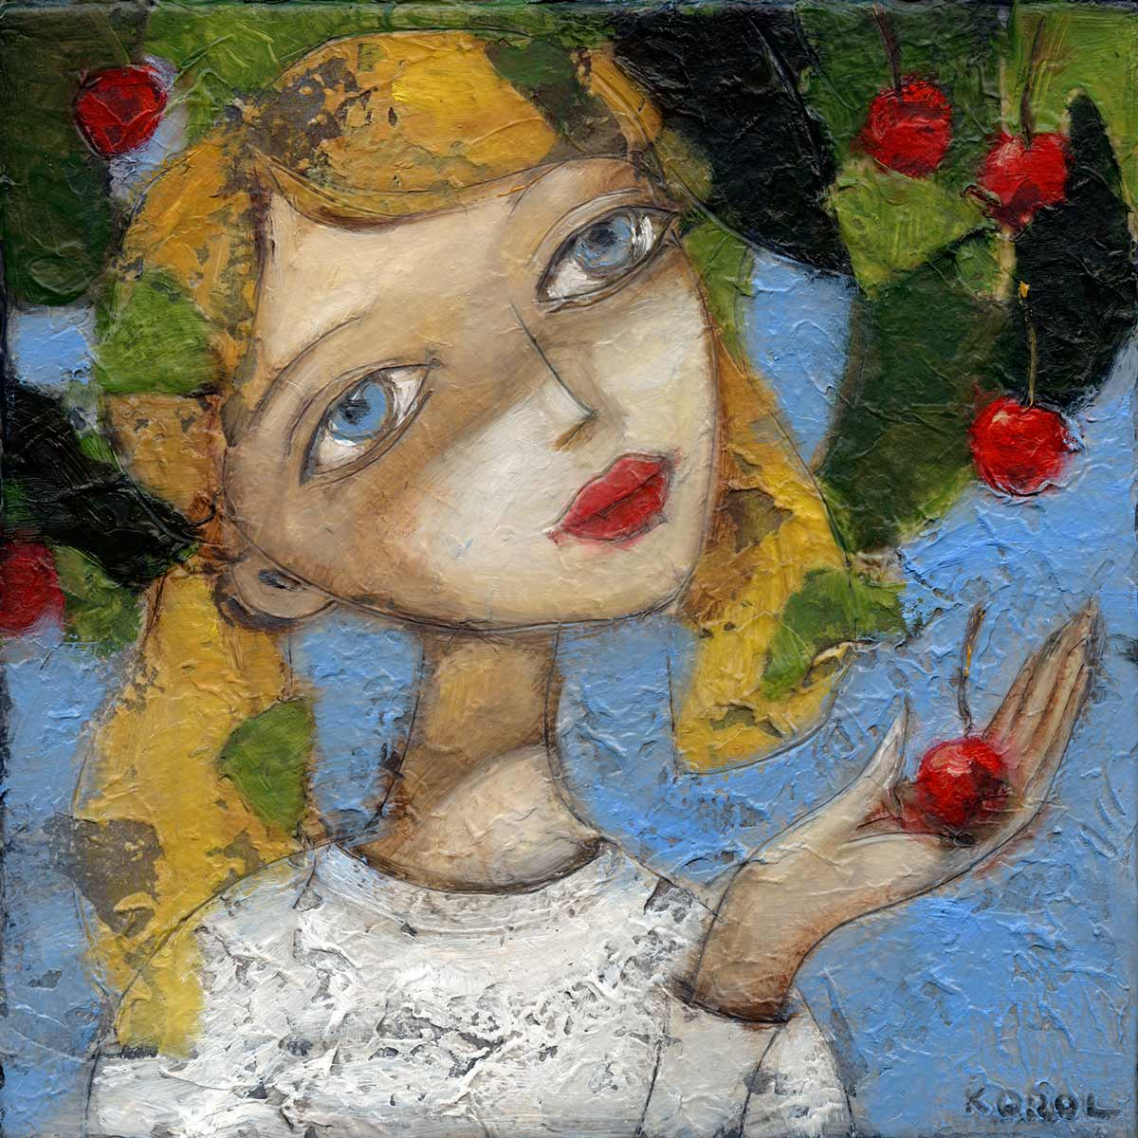
IP at UG and PG
UG: No text book, optional course, six
topics, cherry picking, exam only,
now delivered online. Slides, notes, audio
PG: planning for next semester. Similar
to above. More topics covered. Adapt
course according to class.

Slide 4
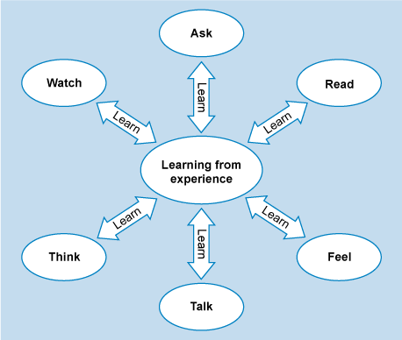
Coronavirus and its implications for teaching
Moved online in March. Hasty videos. Student survey. What did I learn?

Slide 5
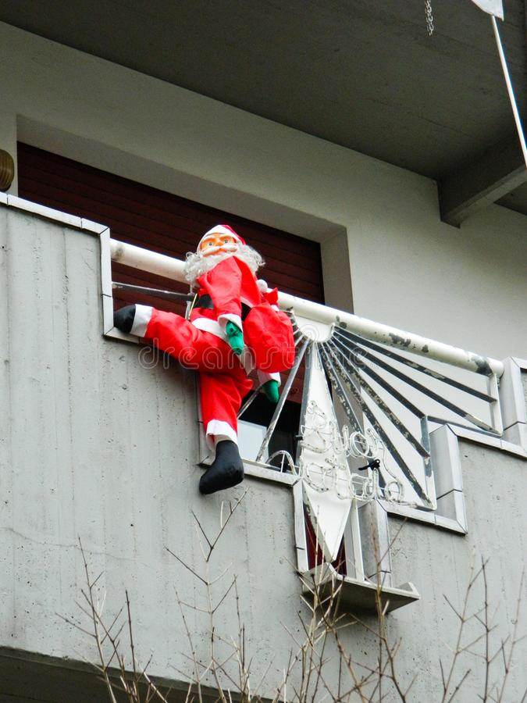
My interpretation of VARK (Visual, Auditory, Read and Write, Kinaesthetic) out the window
(they prefer audio to video)

Slide 6
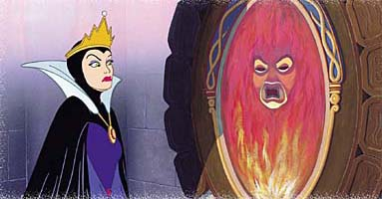
And not have to look at my pretty face
Mirror, mirror on the wall…

Slide 7
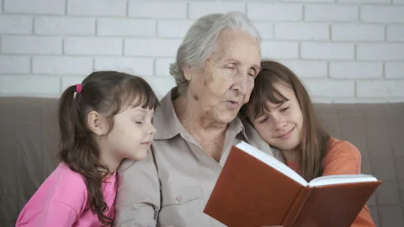
The VARK model
The bookish type are read-and-writes

Slide 8
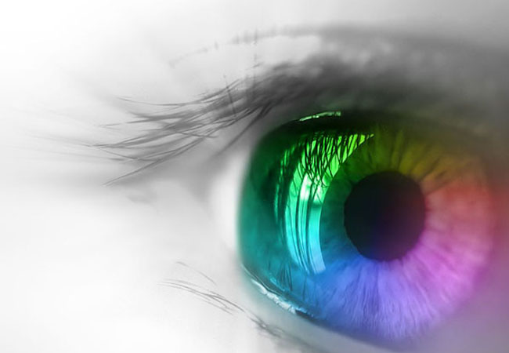
Visual often like media-based subjects and visual aspects of IP such as artistic copyright

Slide 9
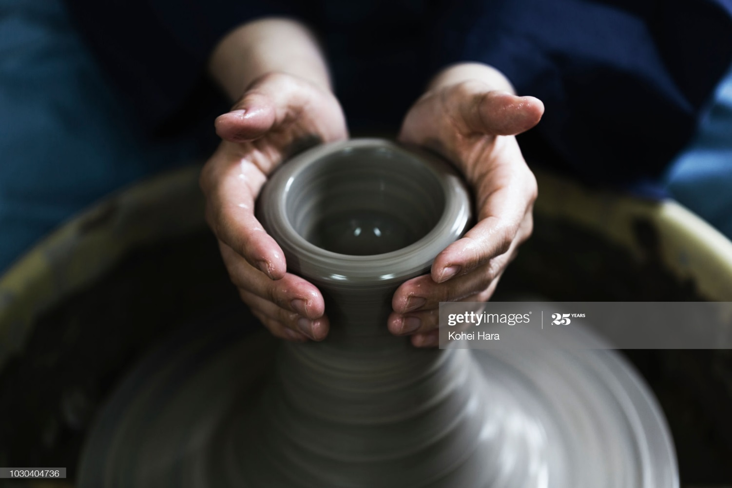
Kinesthetic types are likely to like interdisciplinary modules and hands-on work

Slide 10
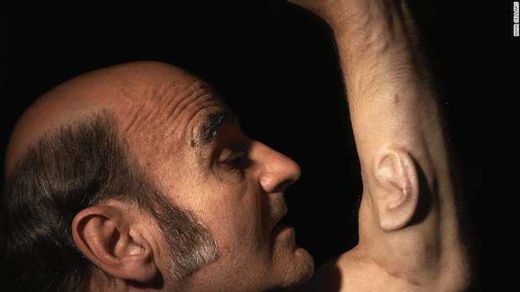
The auditory types are “all ears”
My observation had been
that very few law students are
auditory-types. Some humanities
students are. They sit at the front
and close their eyes.
Online technologies change that

Slide 11
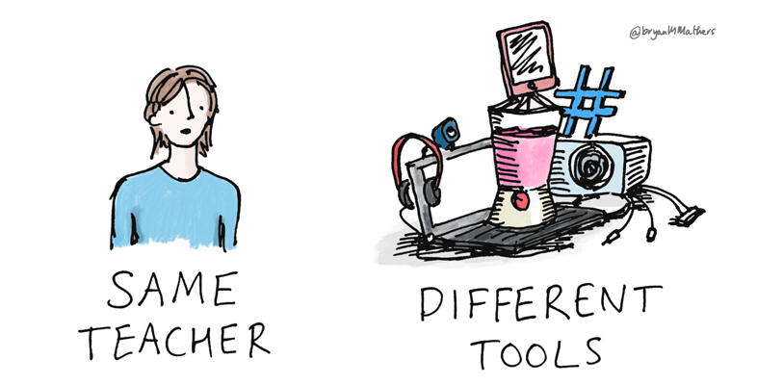
Ireland is now in level 5 lockdown
All university teaching has been online since term began. Our government has specifically said that it will prioritise saving lives and not risk so-called “herd immunity” strategy.

Slide 12
Support for staff
Ground up effort. Several members of staff have attended all sessions run by CELT (Centre for Excellence in Teaching and Learning) over the summer and reported back.
No university-wide policy. Recognised that every discipline differs.

Slide 13
What do students want and what can we deliver?
Blackboard collaborate is the default technology but zoom and MSTeams are also available.
Synchronous lectures, can be streamed (unpopular because of bandwidth issues), recordable and download-able.
Breakout groups – mixed views – very unpopular among students. Silences. Not intuitive for lecturers. More suitable for post-grads or UGs in their final year. Good use of time?

Slide 14
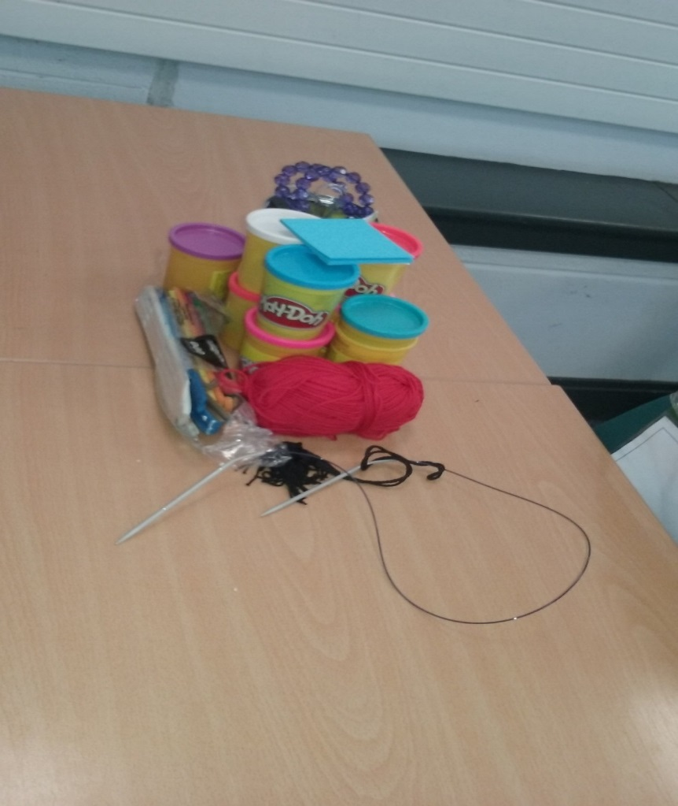
One challenge – the collaborative workshop an artistic copyright – how to recreate this online
Teaching artistic copyright – we look at the law
and then students have to make a work of art in
class. They then test this against the law.
Some innovations – a collection of peeled fruits
presented by one group, highlighting the
impermanence of art and speculation as to the
courts’ response.

Slide 15

Marianne Walsh
BCL and Business (Maynooth University) , LLB (NUI Galway)
PhD Candidate (European Patent Law),
College of Business, Public Policy and Law
NUI Galway

Slide 16

Designing Online PG IP Classes
Options include:
- written assessments.
- reflective logs.
- online group discussions and tasks.
How can we deliver online innovative and interactive PG IP law classes to PG students next semester?

Slide 17

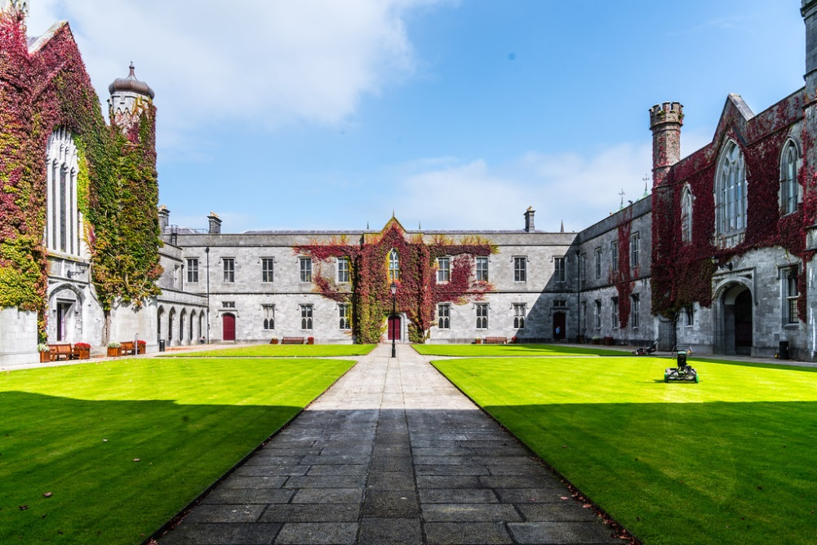
Designing an Online PG IP Law Class
PG students in Ireland are more willing to talk than UG students, so group work tends to work better for them.

Slide 18


How Can Online Group Work be Organised?
It can be built around problem solving and written work.

Slide 19

Organising Problem Solving Online Groups
Discussion groups must be very well structured:
- divide into groups of 3 (max 4) people.
- nominate a timekeeper, a spokesperson and a note-taker.
Set the discussion group a task.
QUESTION: What sort of task?

Slide 20
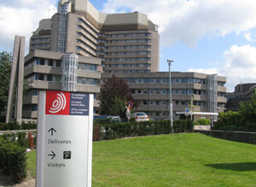
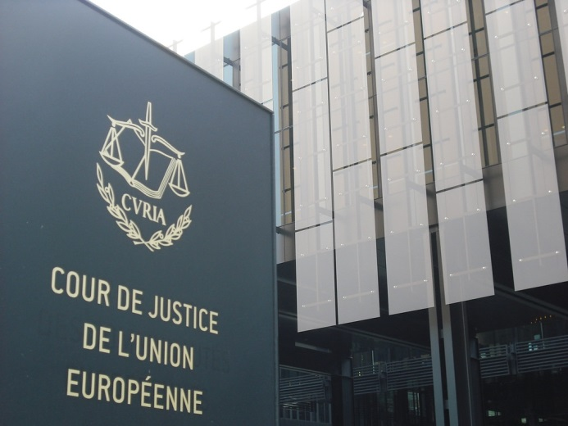
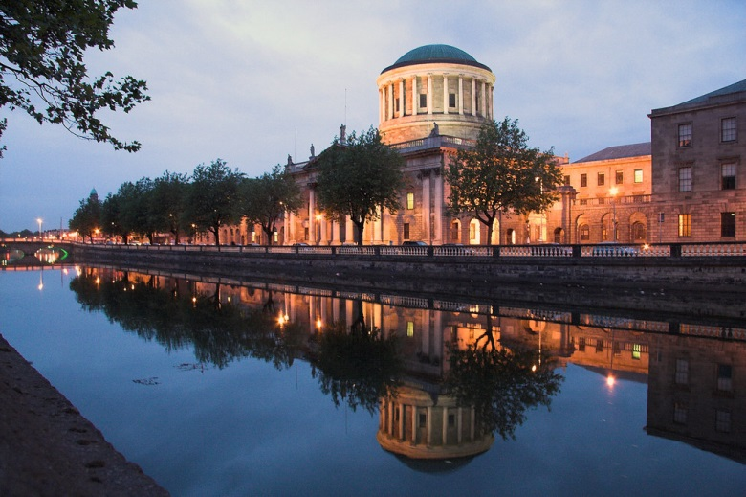
One Example: A Reflection of my own PG Patent Law Learning Experience
I found the complex supranational court structure confusing to learn.
EPOrg (EPO) EU (CJEU) National Courts

Slide 21

An Idea for Online Patent Law Group Tasks
Make a diagram of the court systems.
Put the correct cases in the correct place to demonstrate understanding of the interaction between the EPOrg and the EU.
Describe what gets decided at national courts.
Describe how Brexit is going to change things.

Slide 22


